Slide 1

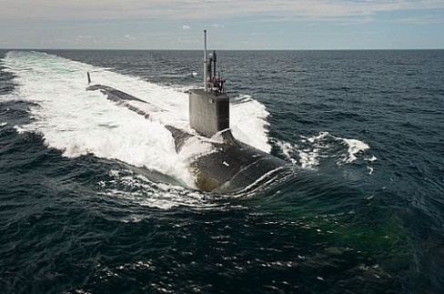
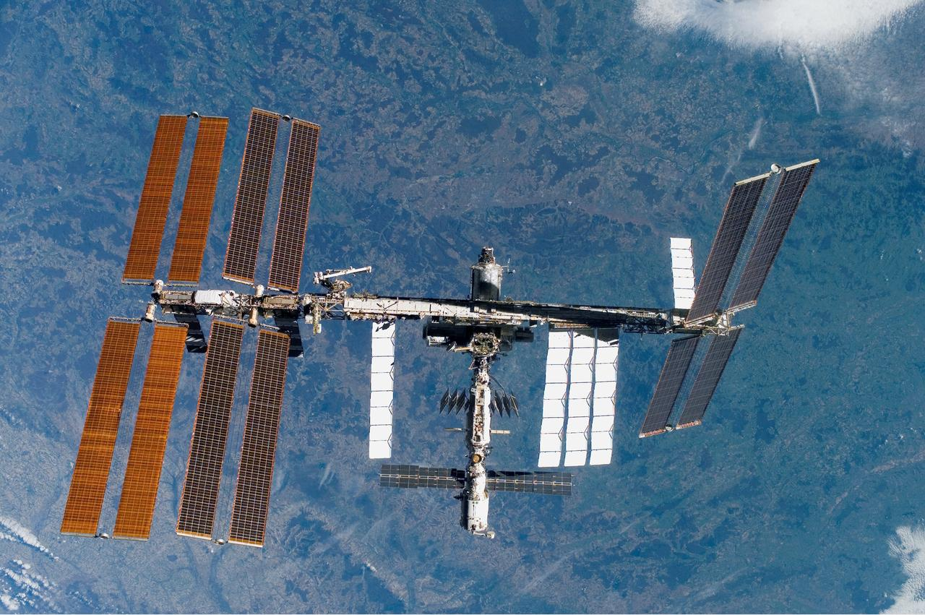

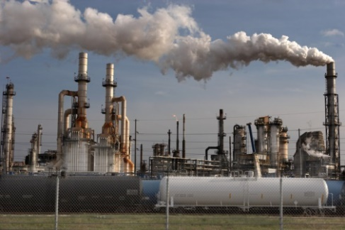
Mosaic Materials provides materials and systems for advanced gas separations
Find us online: mosaicmaterials.com
Visit us in Alameda, CA
Contact us directly:
Jason Husk
VP of Business Development
jhusk@mosaicmaterials.com
+1-925-289-9623
Dr. Thomas McDonald
CEO & Co-Founder
tmcdonald@mosaicmaterials.com
+1-303-578-9567
Life Support Systems
Advanced materials
for a
cleaner
future
Aerospace & Space
Chemicals, Energy,
& Fuels
Carbon Capture

Slide 2
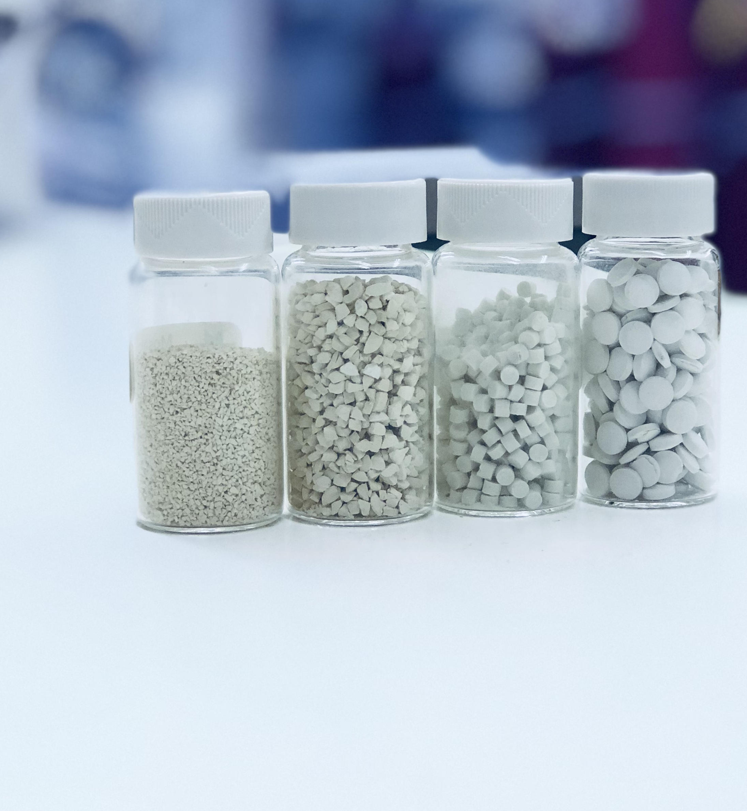
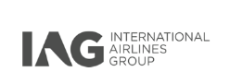

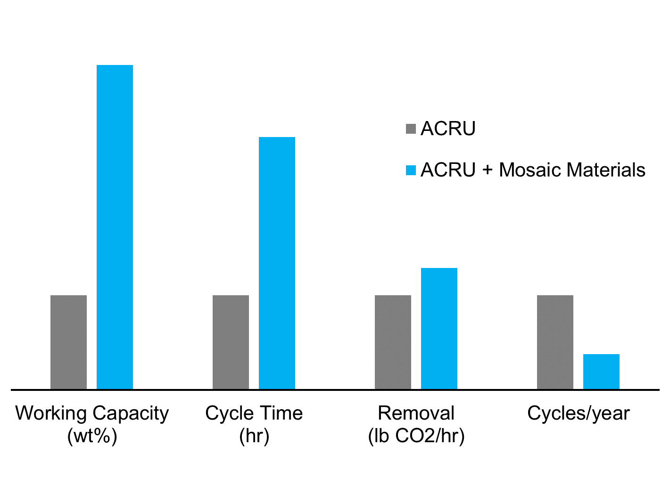

Mosaic’s cooperative adsorption yields higher working capacities and lower energy requirements
Support for development and deployment across public and private industries
Our structured solid adsorbent yields multiple benefits to the warfighter:
Our step-shaped adsorption drives a step change in improving life support system performance
Attributes | Benefits
Higher CO₂ capacity | Longer mission life, less weight
Solid state | Easier, cleaner to maintain
Rapid uptake & regeneration | Less energy usage
Drop-in ACRU replacement | Lower cost

