Slide 1

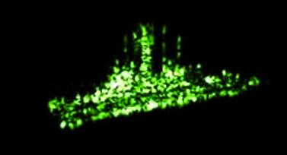

Science Systems Solutions, Inc.
Sigma-3
Leveraging machine learning and artificial intelligence to optimize real-time multi-sensor signal and image processing, accurately model scene phenomenology – Observe, Detect, Identify, and Classify
310 Via Vera Cruz, Suite 208 San Marcos, CA 92078, (858) 753-3234, duy@sigma-3.com

Slide 2

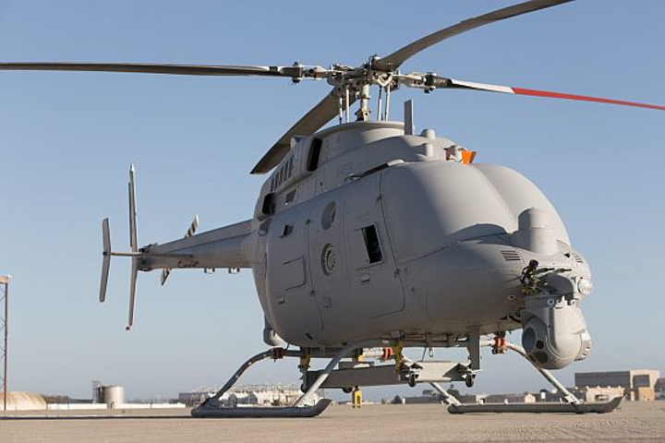
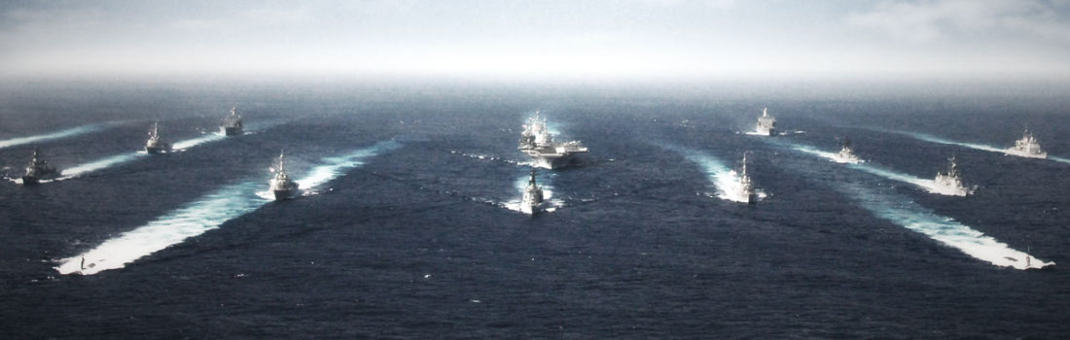
Sigma-3
Core Capabilities
Intelligence, Surveillance, and Reconnaissance (ISR)
Multi-Sensor, Multi-Modality Data Fusion
Advance Automated Target Recognition Algorithms
Data Fusion or correlated EO, IR, Radar Data Sources
New methodologies in machine learning
Deep learning convolutional neural network (CNN)
Compressive manifold learning (CML)
Integration with modern mobile computing devices
Real-time performance
Constrained Size, Weight, and Power Application
Sigma-3 Technologies
Science Systems Solutions’ has developed land and maritime synthetic aperture radar/inverse synthetic aperture radar (SAR/ISAR) imaging, detection, tracking, target classification, modeling and simulation (M&S), multi-sensor fusion, and feature-aided tracking technology.
Technology Applications
Navy MQ-8B Fire Scout
Navy MH60-R
Navy AN/APS-149 Littoral Surveillance Radar System (LSRS)Navy P8
Air Force Joint Surveillance and Target Attack Radar System (JSTARS)
Numerous other platforms
3-Sigma DoD Programs
Science Systems Solutions’ has been developing intelligence, surveillance and reconnaissance (ISR) and tactical exploitation algorithms in support of land, air, and maritime missions for the past 25+ years
Defense Research Project Agencies’ (DARPA) - Moving Target Exploitation (MTE) Program
DARPA- NETRACK Program,
Office of Naval Research’s (ONR) - Distributed Agile Submarine Hunting (DASH) Program
Air Force Research Laboratory’s (AFRL) - Gotcha Radar Program,
Navy - Littoral Surveillance Radar System (LSRS) Program,
Numerous classified programs
310 Via Vera Cruz, Suite 208 San Marcos, CA 92078, (858) 753-3234, duy@sigma-3.com

Slide 3
Sigma-3
Machine Learning Multi-Sensor Fusion - Detect, Track Classify
Machine Learning Approach
3-Sigma’s machine learning (ML) approach simultaneously uses two complementary techniques
  Deep learning convolutional neural network (CNN)
  Compressive manifold learning (CML)
Exploits automatic feature and regularities discovery of deep learning to fuse multi-sensor data and data sparsity representations
Manifold learning is leveraged to fuse raw sensor data as represented by highly compressed lower dimensional manifolds.
This two-prong approach, combined with the baseline handcrafted features used to augment features discovered by the deep learning CNN algorithm, provides unprecedented robust ship classification and potentially identification performance
310 Via Vera Cruz, Suite 208 San Marcos, CA 92078, (858) 753-3234, duy@sigma-3.com

Slide 4
Sigma-3
Transitioning Technology through the SBIR/STTR Program
Fusion of Radar and Electro-Optical/Infrared (EO/IR) for Ship Classification and Identification (N172-108-0502, N68936-19-C-0024)
Sigma-3 demonstrates that dramatic classification performance gain can be achieved using a two-prong machine learning approach that simultaneously uses two complementary techniques, deep learning CNN and manifold learning, to exploit the automatic feature and regularities discovery of deep learning to fuse the multiple sensor data and the sparsity representation of the data in manifold learning to fuse the raw sensor data as represented by their highly compressed lower dimensional manifolds
Compressive Sensing Application to Real-Beam Inverse Synthetic Aperture Radar (ISAR) Imaging and Automatic Target Recognition (N191-004, N68335-19-C-0333)
Developed a novel compressive analog-to-feature converter that extracts the salient features and dominant scatterers from the limited radar pulses directly from the analog signal within the CS framework. The extracted scatterers range-Doppler locations are then tracked over multiple frames of radar pulses as the weapon flies in to assure consistency and provided to a maximum a posteriori (MAP) estimator that then estimates the scatterers 3-D locations (i.e., point cloud image) by solving for the unknown coefficients in the dynamical equations of motion of the ship. We then drape the extracted features over the point cloud image using standard photogrammetry approaches and apply an iterative closest point approach to classify the ship by matching against existing CAD models.
Advanced Machine Learning Fusion of Radar and EO/IR/LIDAR for Ship Classification and Identification (N172-108, N68936-18-C-0007)
We propose a two-prong machine learning approach that simultaneously uses two complementary techniques, deep learning CNN and manifold learning, to exploit the automatic feature and regularities discovery of deep learning to fuse the multiple sensor data and the sparsity representation of the data in manifold learning to fuse the raw sensor data as represented by their highly compressed lower dimensional manifolds. This two-prong approach, combines with the baseline handcrafted features used to augment the features discovered by the deep learning CNN algorithm, will provide unprecedented robust ship classification and potentially identification performance
310 Via Vera Cruz, Suite 208 San Marcos, CA 92078, (858) 753-3234, duy@sigma-3.com

Slide 5

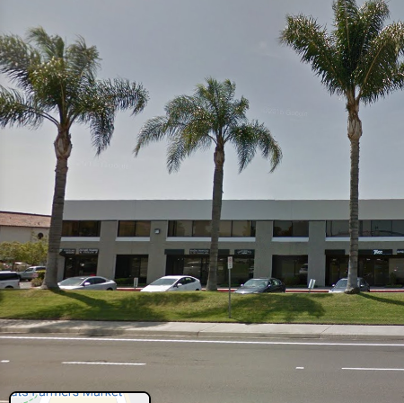
Sigma-3
About Sigma-3
Sigma-3, founded in 2016, focuses on research and development in sensor and software-based phenomenology, information, and decision systems. Sigma-3’s core capability include signal and image processing, phenomenology understanding, machine learning, real-time embedded software, and sensor and performance modeling & simulation.
Chief Executive Officer
Dr. Nguyen has over 20 years of experience in ISR exploitation, control system, optimization, radar/EO/IR/LADAR/SIGINT systems development and processing, missiles guidance and control and signal processing, electronic warfare/electronic protection. He previously worked for Leidos/SAIC, HRL Laboratories, MIT Lincoln Laboratory, and the NASA Jet Propulsion Laboratory. Dr. Nguyen holds a Ph.D. in electrical engineering, M.S. in electrical engineering, and B.S. in mathematics and engineering.
President
Dr. Chen has over 17 years of experience in space-based sensor development, optical/LIDAR imager sensor signal processing algorithm, flight SW development/integration/testing on embedded real-time system, system performance characterization, radar signal processing/exploitation/algorithm development, and modeling & Simulation. He previously worked for Leidos/SAIC, Arete Associates, and Parasoft Corporation. Dr. Chen holds a Ph.D., M.S., and B.S. all in physics.
DUNS: 080336557
CAGE: 7PHN8
Sigma-3, www.sigma-3.com, Asian-Pacific,
Women-Owned, American Owned Small Business
310 Via Vera Cruz, Suite 208 San Marcos, CA 92078, (858) 753-3234, duy@sigma-3.com

