Slide 1
SimVentions 20+ Year SBIR Journey
Joe Caliri, SimV President
joecaliri@simventions.com
March 2025
© 2025 SimVentions, Inc. All Rights Reserved

Slide 2





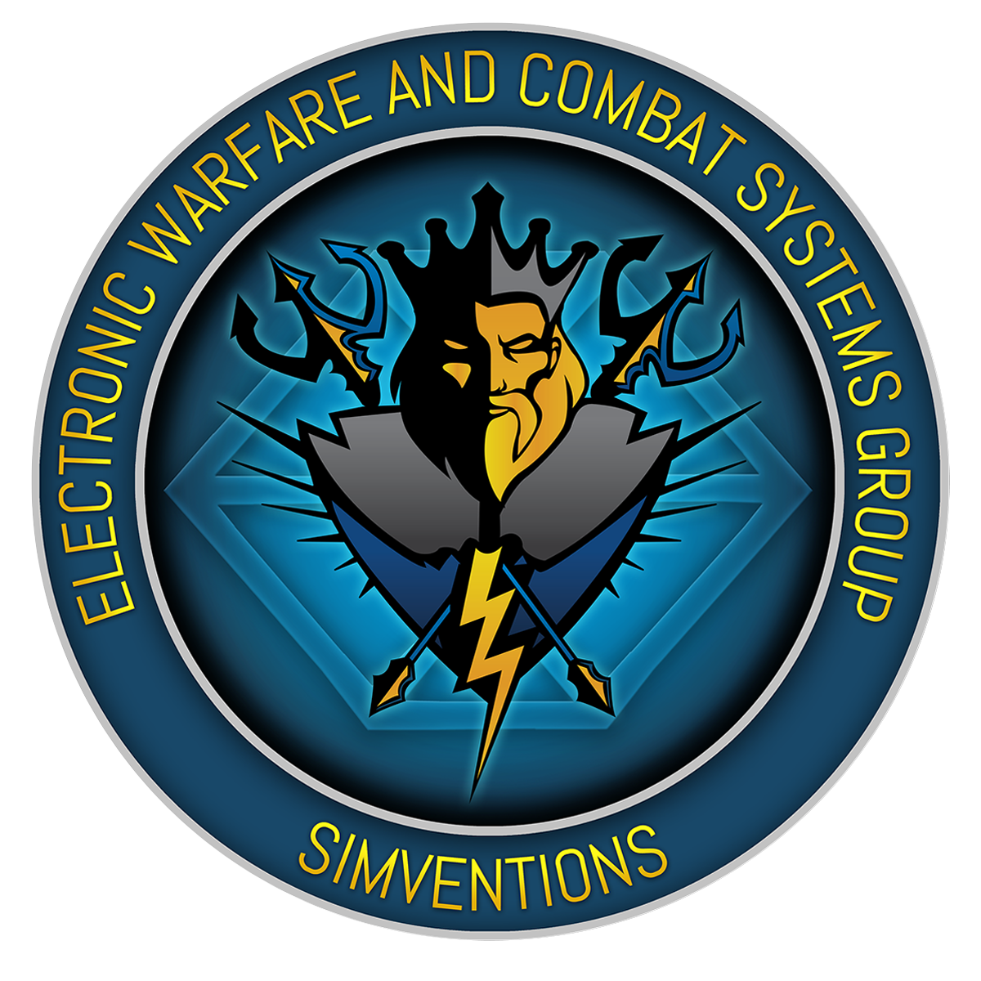
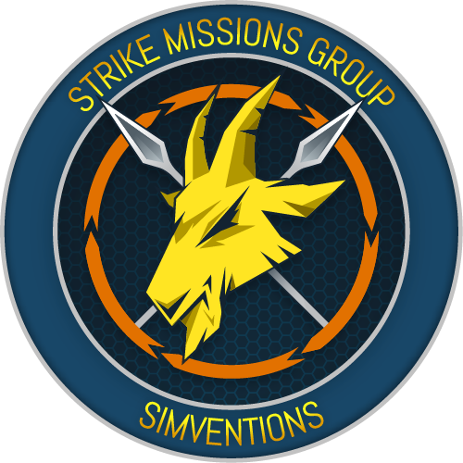

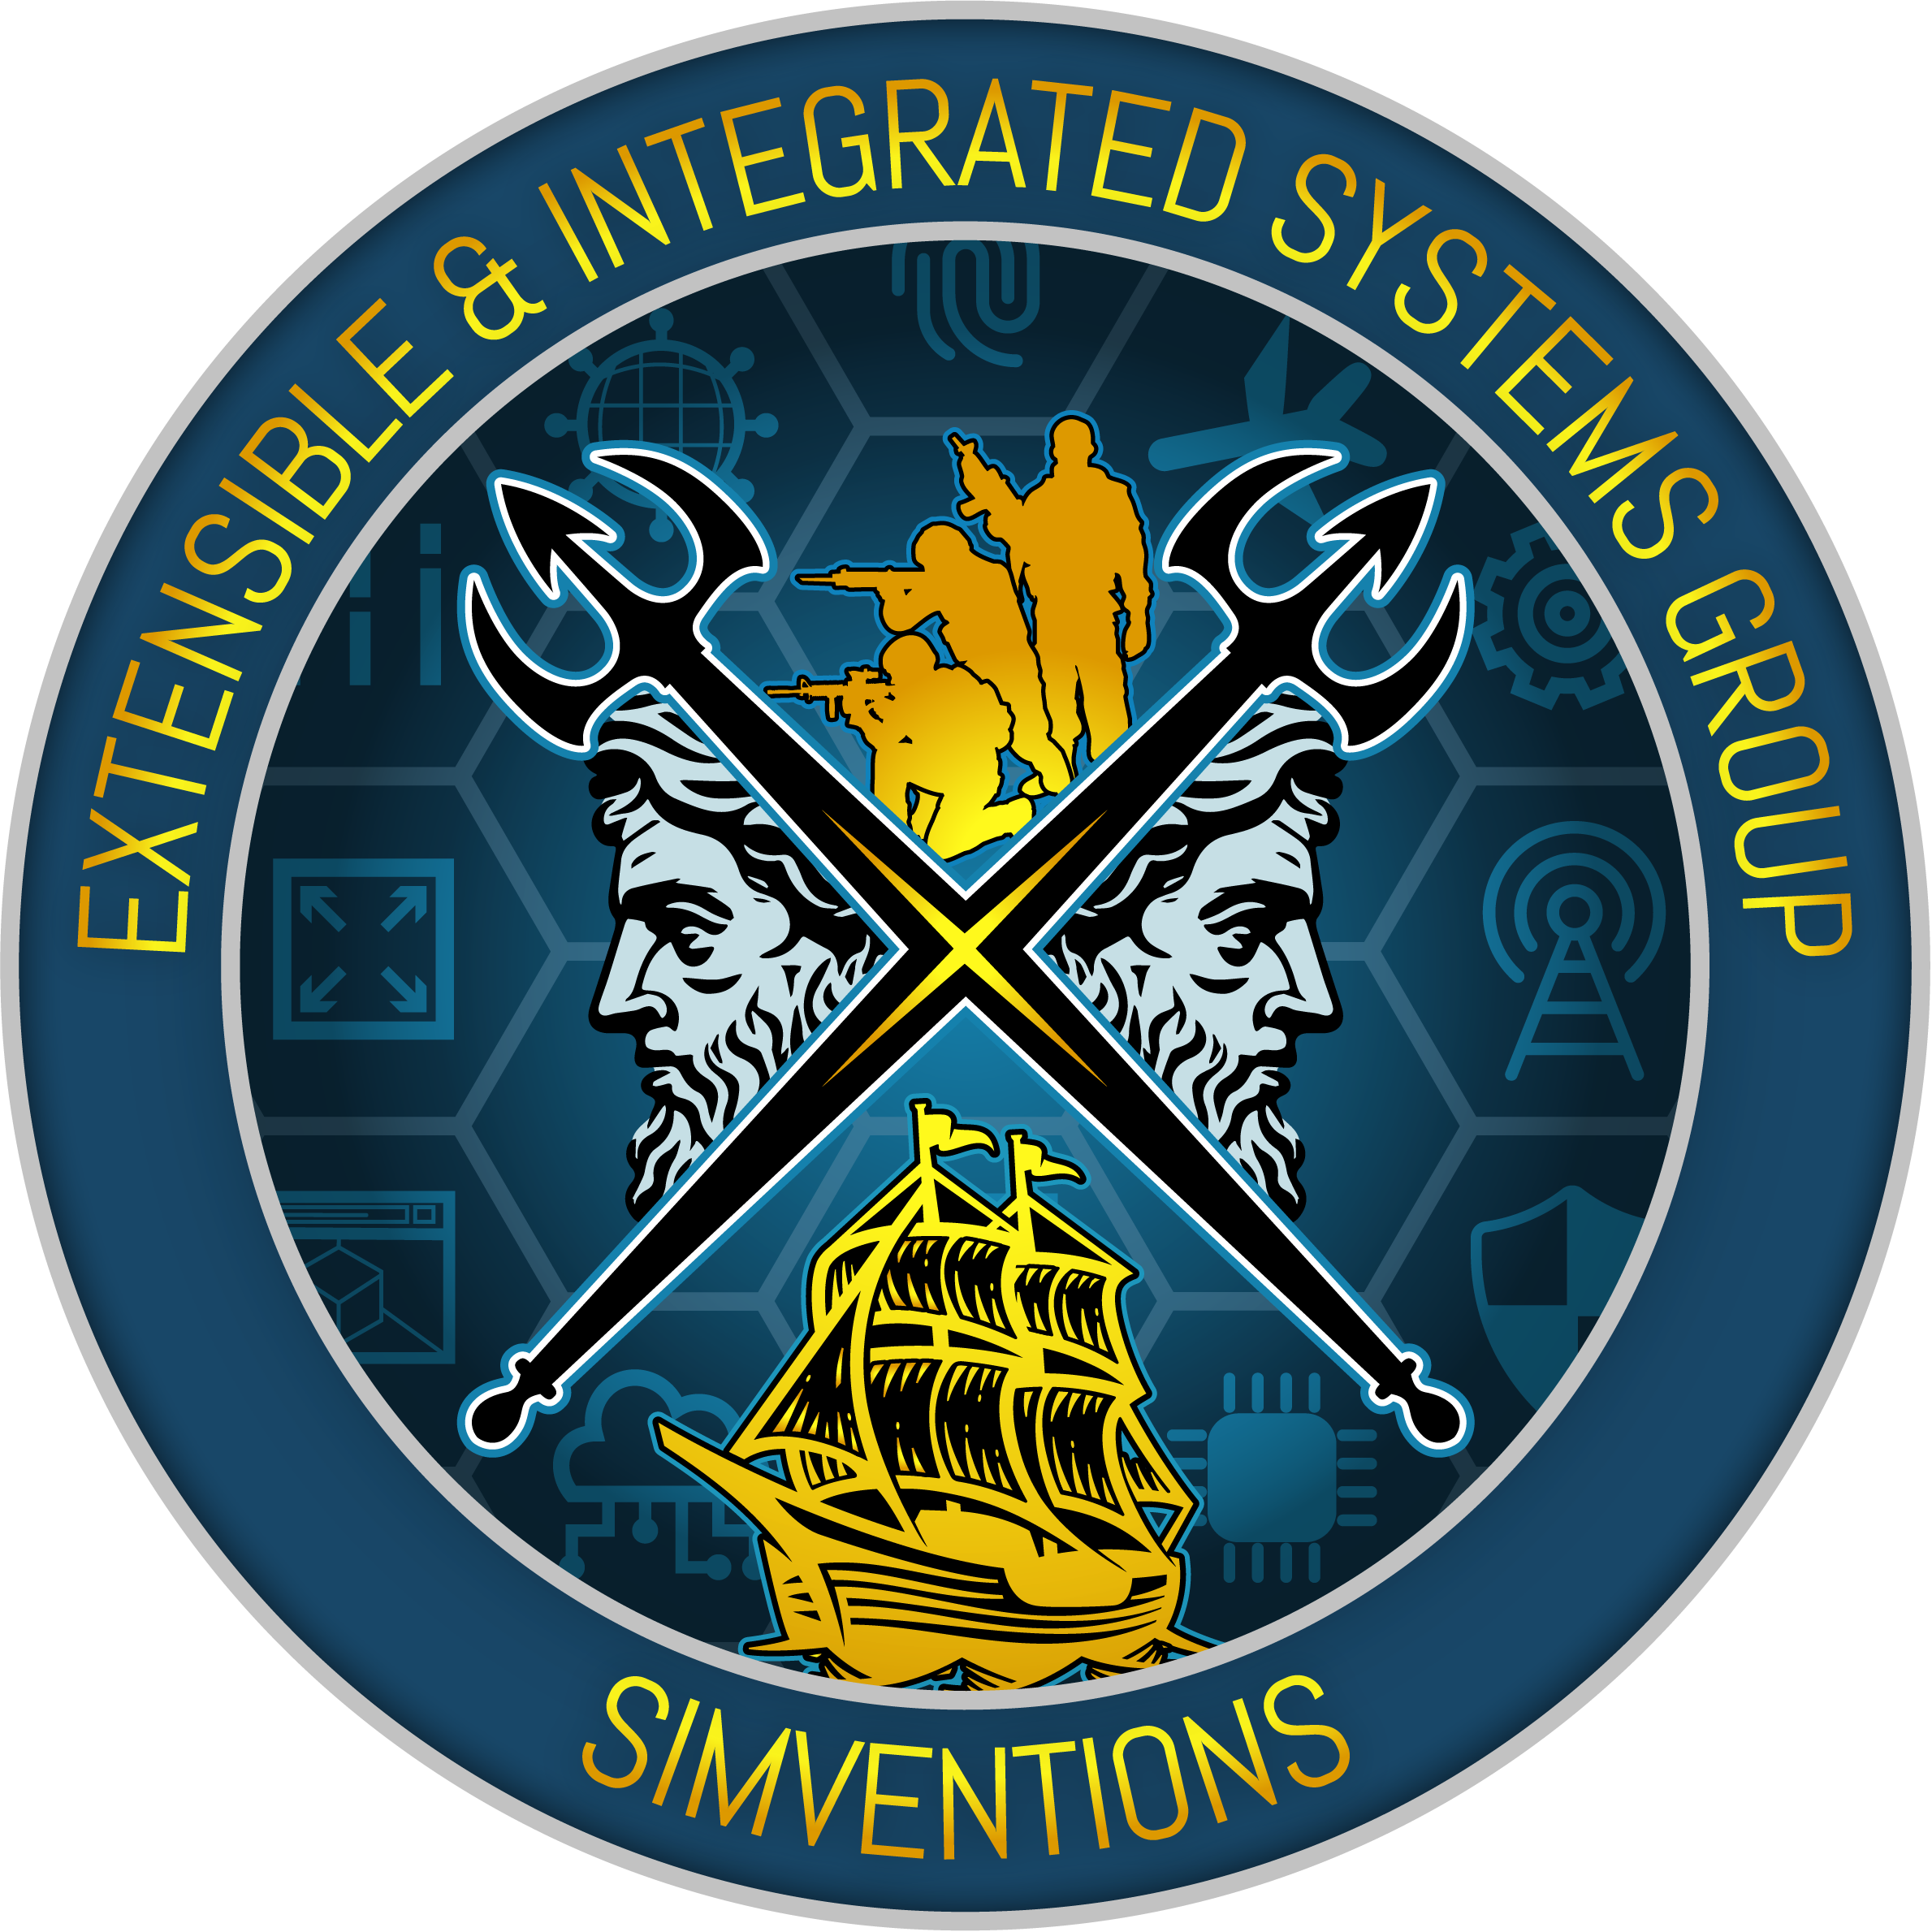









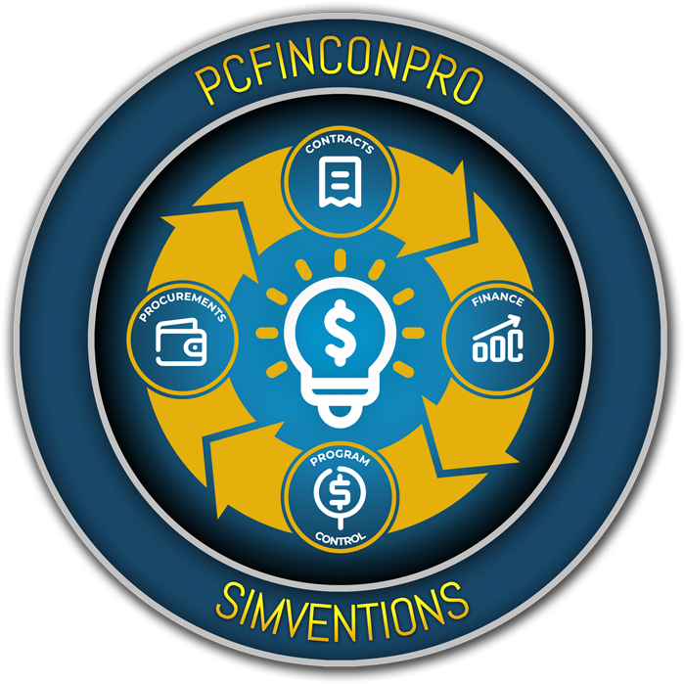
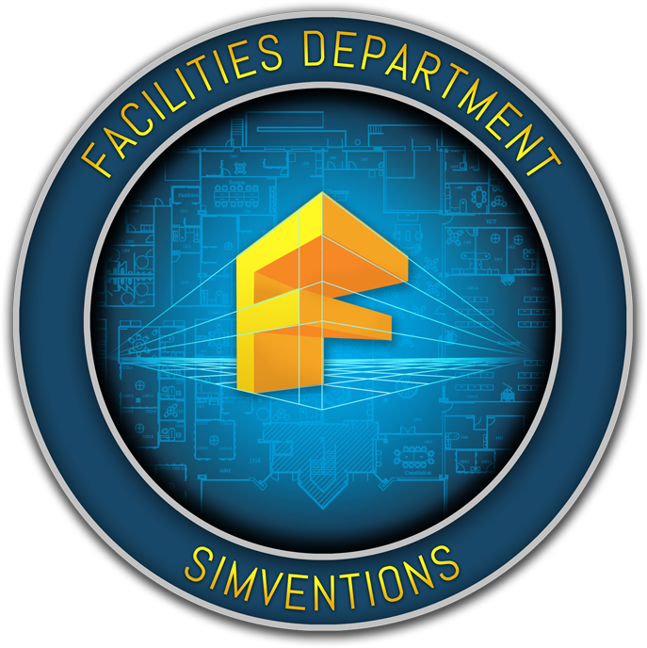



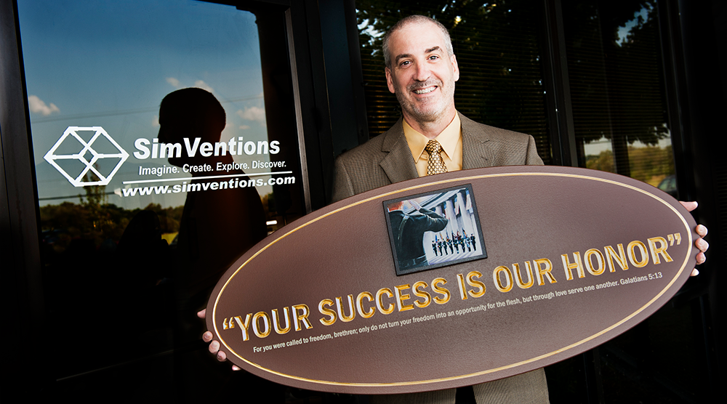
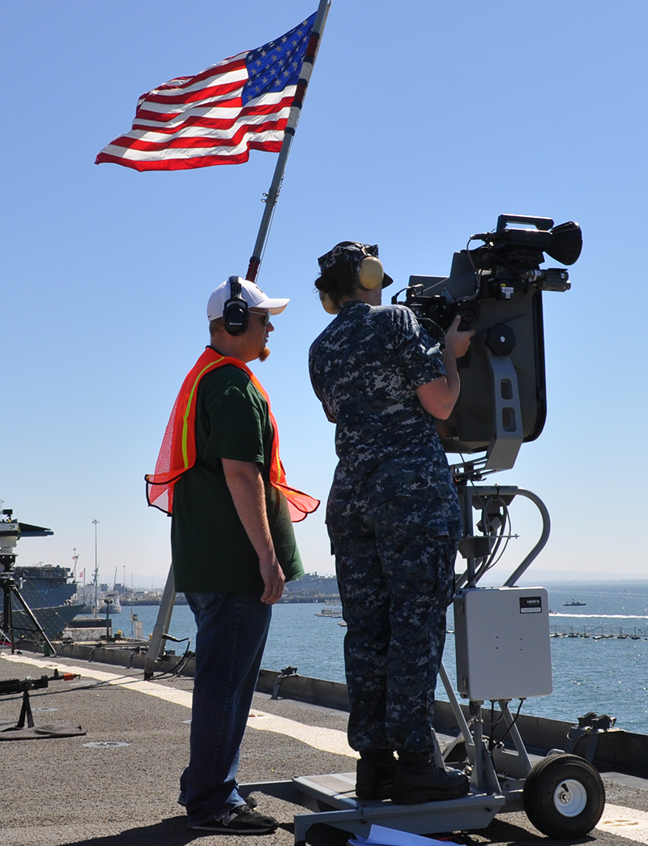
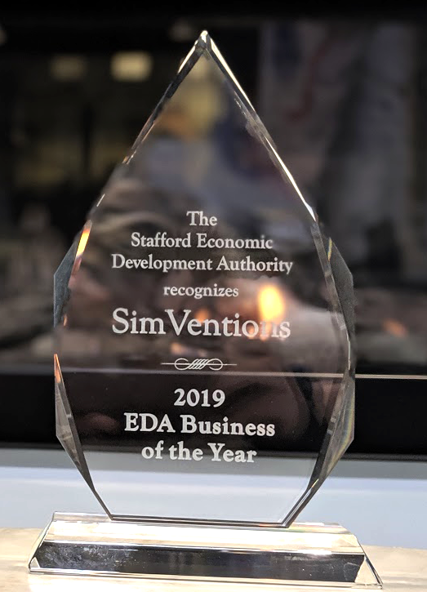
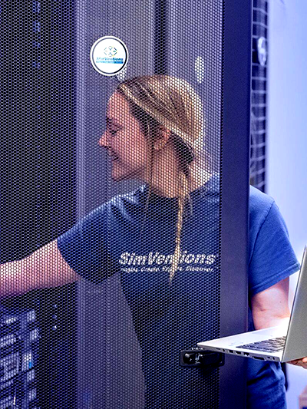
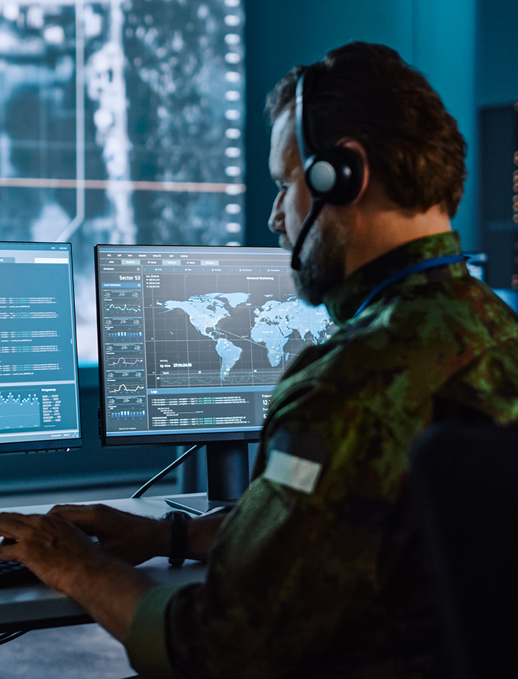
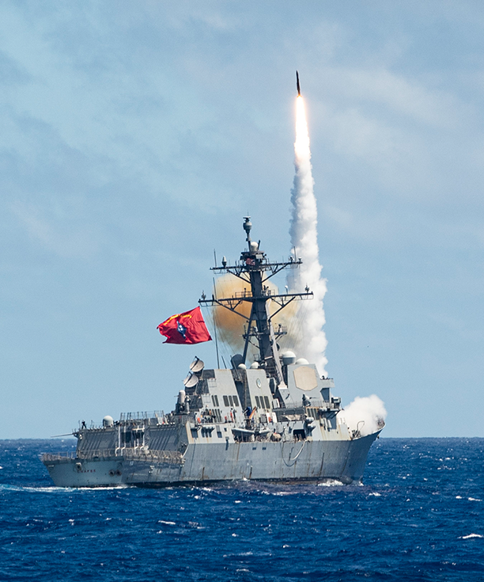



Who is SimV?
We are a 100% employee-owned defense contractor who develops, integrates, and transitions new technology to our country’s warfighters.
© 2025 SimVentions, Inc. All Rights Reserved

Slide 3
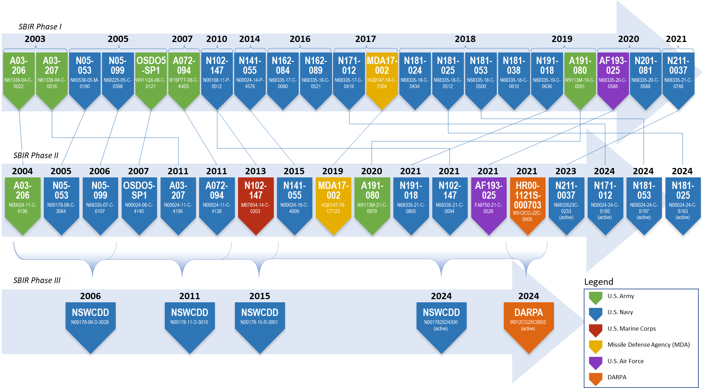
SimV SBIR History

Slide 4
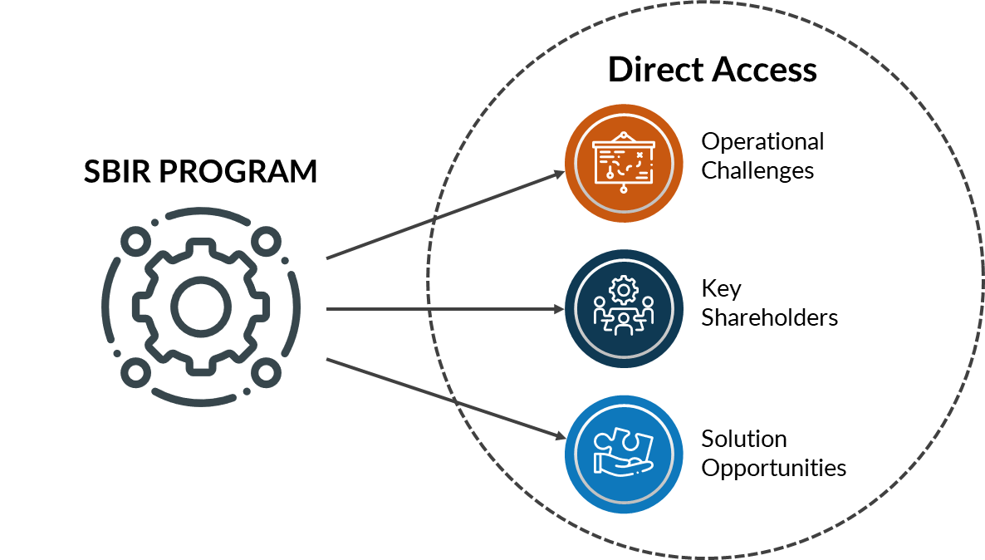
Open Doors

Slide 5

Think Beyond Your Limits

Slide 6
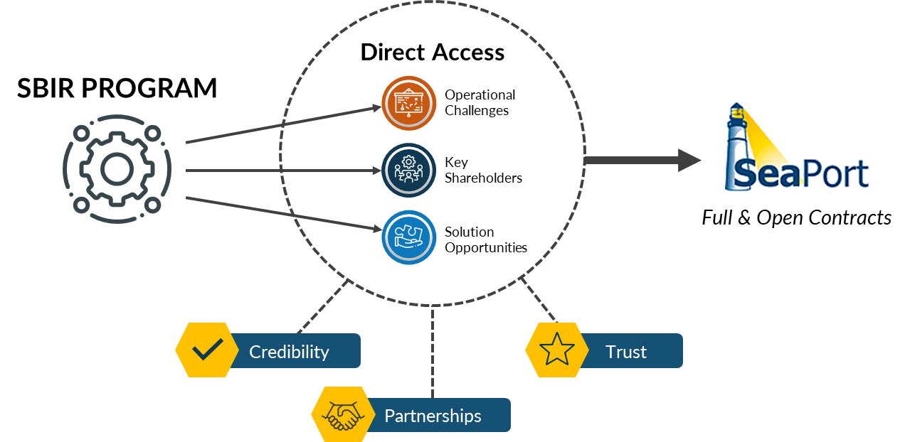
Become Credible Trusted Partners

Slide 7
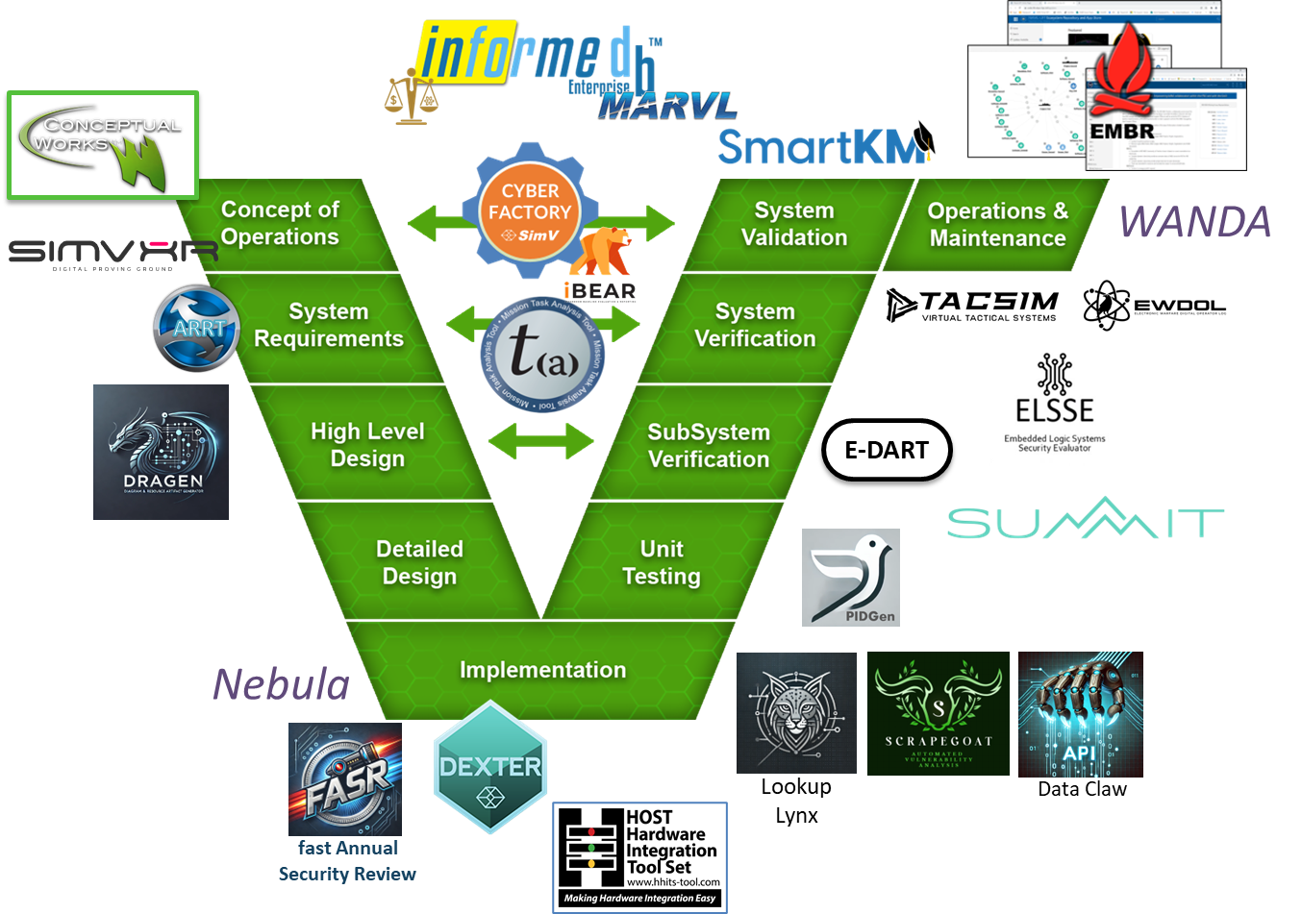
Find and Leverage Your Niche

Slide 8
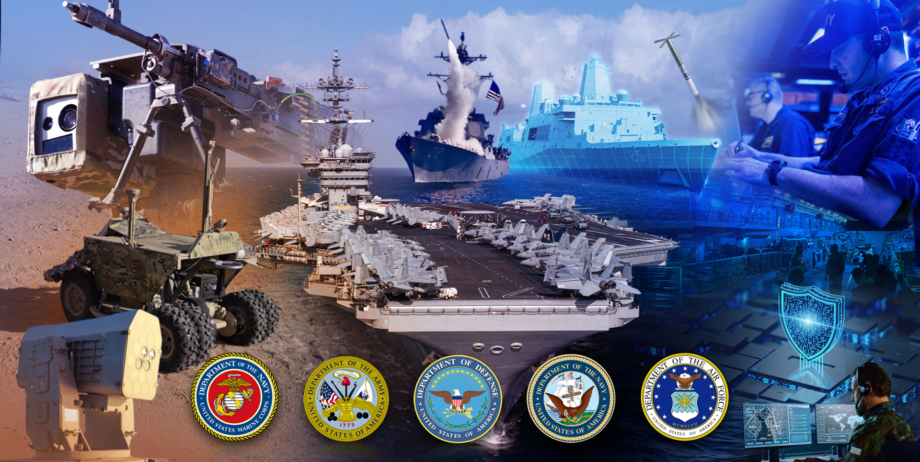
Build Technical Excellence

Slide 9
Lessons Learned / General Advice
Take advantage of what the STP provides, it worked for us!
Be your best marketer, don’t expect the government to do it all for you
SBIRs are basically your IR&D as a small business
Pay attention to your data rights, but don’t die on your sword
Follow up, don’t expect the large primes to make you a priority
Don’t underestimate the value of a great:
  Application Story – Focus on the “Why”…more “Benefits” less “Features”
  Abstract
  Commercialization Plan

Slide 10

Questions/How can SimV Help?
“Your Success is Our Honor”™
Joe Caliri, SimV President
joecaliri@simventions.com
© 2025 SimVentions, Inc. All Rights Reserved

