Slide 1


MISSION POSSIBLE
DLA TLS SOE CONTRACT BRIEF
NOBLE SUPPLY & LOGISTICS, LLC | NOBLE.COM
March 2025

Slide 2


YOUR TRUSTED PARTNER IN READINESS
NOBLE provides global sustainment and operational support for the U.S. military and civilian government agencies with an unparalleled range of mission-critical products and services.
Our supply chain contains over 15,000 suppliers and millions of products. We offer top brands and cutting-edge technologies to assist with your equipment's total life-cycle sustainment.
Headquarters: Boston, Massachusetts
15,000 Suppliers
1M+ Products
50 Locations
150+ Contract Vehicles
Certified Small Business
ISO Certifications: 9001:2015, 14001:2015
DLA TLS Prime Vendor
NOBLE SUPPLY & LOGISTICS, LLC | NOBLE.COM

Slide 3

DOMAINS
NOBLE’S AREAS OF SUBJECT MATTER EXPERTISE
NOBLE offers rapid acquisition of commercial-off-the-shelf technology to support the U.S. military, civilian government agencies, and private sector customers. NOBLE Subject Matter Experts (SMEs) understand our customer’s requirements, offer the best solutions, and provide installation, training, and service throughout their product's life cycle.
AEROSPACE
C5ISR
CBRNE
EXPEDITIONARY
MRO
TACTICAL
NOBLE SUPPLY & LOGISTICS, LLC | NOBLE.COM

Slide 4
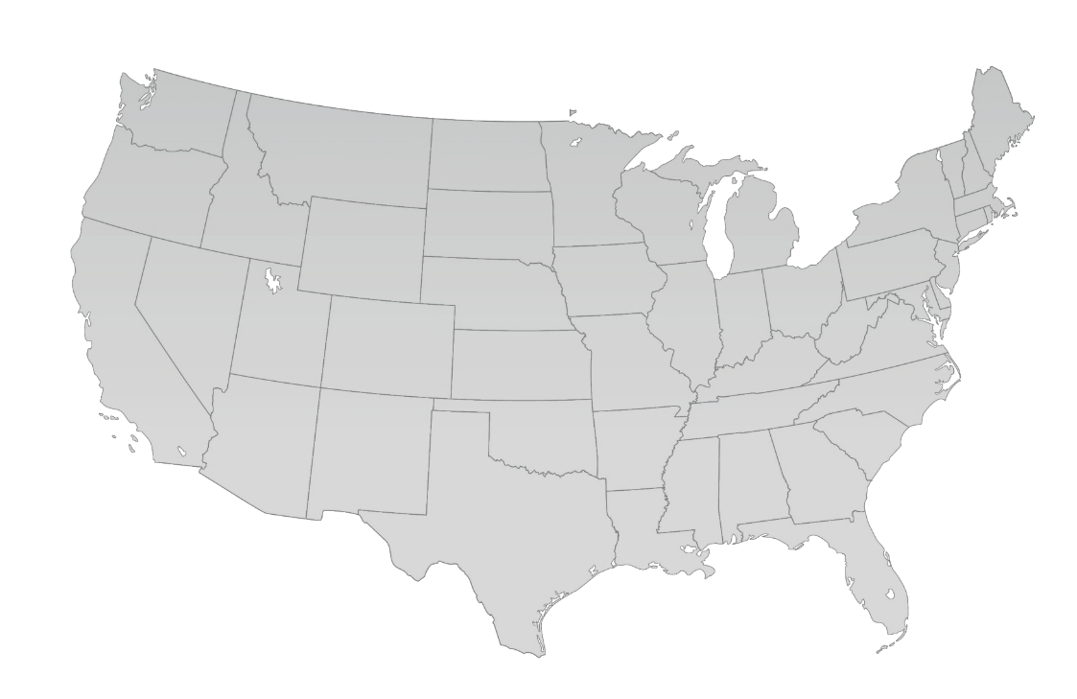
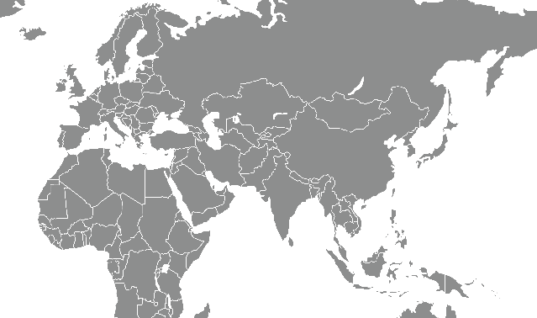

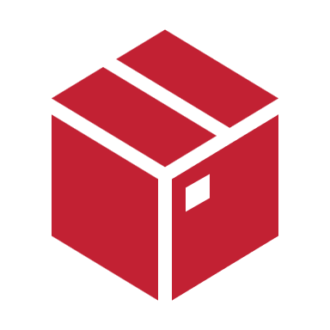

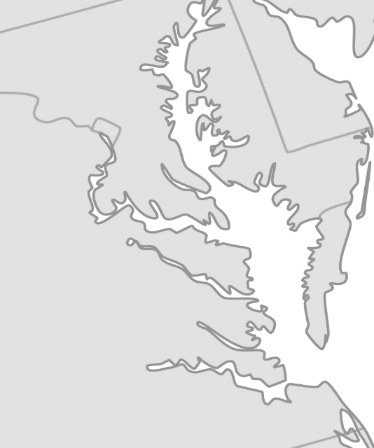
Global Footprint
GERMANY
KAZAKHSTAN
SEATTLE
DISTRIBUTION CENTER
JAPAN
WOODBURN, OR
NOBLE HQ
BOSTON, MA
DJIBOUTI
MONTGOMERY
NY
NOBLE provides on-time delivery, even to the most remote locations.
MEDINA, OH
LETTERKENNY ARMY DEPOT
STEVENSVILLE
ABERDEEN PROVING GROUNDS
SACRAMENTO
DIXON, IL
ALEXANDRIA
MESQUITE, NV
HARRISONBURG
PAX RIVER
NELLIS AFB
SIKESTON, MO
CHESAPEAKE
LAS VEGAS DISTRIBUTION CENTER
LEXINGTON
PENTAGON
LOS ANGELES DISTRIBUTION CENTER
FT. BELVOIR
ANNISTON
ARMY DEPOT
NOBLE PAX RIVER
OLIVE BRANCH DISTRIBUTION CENTER
NAVAIR
Operations Center
Storefront
Technical Service Center
Distribution Center
Fulfillment Center
WACO, TX
HURLBURT FIELD AFB
LANGLEY AFB
LITTLE CREEK
NOBLE Operation Centers are strategically placed near major Atlantic-Region customers.
OCEANA
NORFOLK NAVAL STATION
NOBLE SUPPLY & LOGISTICS, LLC | NOBLE.COM
NORFOLK NAVAL SHIPYARD
DAM NECK
NOBLE CHESAPEAKE

Slide 5
MISSION POSSIBLE
Defense Logistic Agency Tailored Logistics Support
Special Operations Equipment
NOBLE SUPPLY & LOGISTICS, LLC | NOBLE.COM

Slide 6


DLA TLS SOE Overview
MISSION POSSIBLE
Defense Logistics Agency (DLA) Tailored Logistics Support (TLS) Programs
Special Operations Equipment (SOE) Program
The Special Operational Equipment (SOE) Program, one of six contracts under the TLS program, provides responsive procurement assistance to military installations, federal agencies, and other Army, Navy, Air Force, Marine Corps, and Coast Guard customers worldwide. Equipment categories include Aerospace, C5ISR, CBRNE, Expeditionary, MRO, Tactical and more.
PRIME CONTRACTORS
Noble Supply & Logistics – Boston, MA
Atlantic Diving Supply, Inc – Virginia Beach, VA
SupplyCore, Inc – Rockford, IL
W.S. Darley & Co – Itasca, IL
NOBLE works with the DLA Troop Support Construction & Equipment to provide supply chain management, a single point to consolidate fulfillment of requirements, 24/7 support, custom systems integration, and an infrastructure of operations centers and warehouses to maintain supply and facilitate delivery. Our contingency capabilities cover national emergencies, natural disasters, relief efforts, and troop deployments.
NOBLE SUPPLY & LOGISTICS, LLC | NOBLE.COM

Slide 7
DLA TLS SOE Scope
MISSION POSSIBLE
Scope Determination
A Sole-Sourced Firm-Fixed Price contract
Modified Commercial Off the Shelf (COTS) hardware and software items. Services, warranties and maintenance plans may be added as separate lines in support of the hardware and software procurement.
Each line item of every order is reviewed independently for scope determination by the DLA Troop Support, Construction & Equipment contracting team. Prior scope approval and/or order award does not constitute guaranteed scope approval on a new order submission of the same products.
Additional Information: The following information is used to facilitate scope determination:
      Detailed description of the item
Explain how this item supports the warfighter mission
Link to website for the item
Further description of how the item is within scope of the SOE program
NOBLE SUPPLY & LOGISTICS, LLC | NOBLE.COM

Slide 8
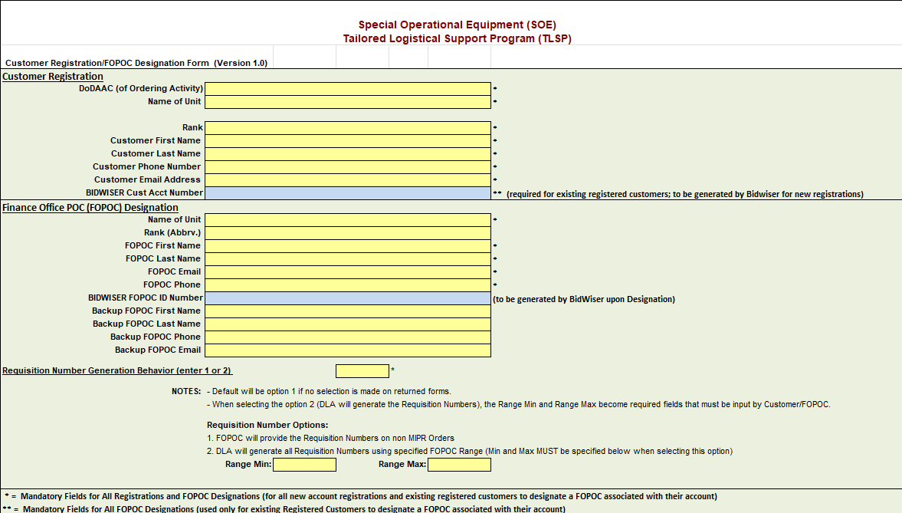
DLA TLS SOE Registration Form
MISSION POSSIBLE
The registration form must be completed for each customer
Prime representatives may assist with registration completion
A Finance Office Point of Contact (FOPOC) is required for each account registration. A FOPOC is someone that can obligate funds on behalf of the program, unit, agency, etc.
Once completed and submitted, DLA will provide a welcome packet with your account number and ordering template within 72 hours
A Tailored Vendor Logistic Support (TVLS) representative will be assigned to you for future assistance

Slide 9
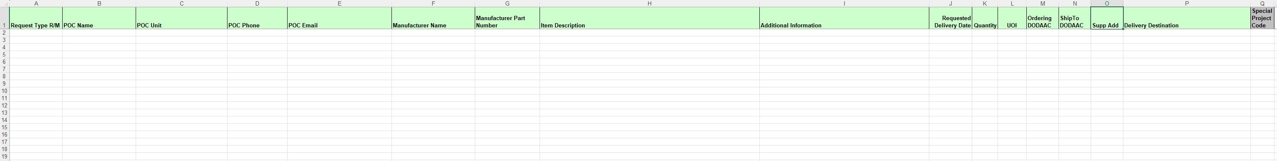
DLA TLS SOE Customer Orders
MISSION POSSIBLE
All customer requests are UNFUNDED when initially submitted DLA Troop Support.
The Excel SOE Order Spreadsheet (below) and Customer Guidelines Document detail the ordering process. Please be sure to read this Customer Guidance Document prior to submitting your first order under this new process
NOBLE SUPPLY & LOGISTICS, LLC | NOBLE.COM

Slide 10
DLA TLS SOE Contract Usage Fee & Timeline
MISSION POSSIBLE
Cost Recovery Rate (CRR)
Orders are process with a 5.4% CRR. Orders exceeding $5 million (total value unburdened value) will incur a CRR of 2.0% in lieu of the standard 5.4% CRR.
Program Standard Timeline:
The Govt. submits a completed customer request form to DLA. DLA ensures the hardware and/or software meet(s) the scope criteria.
A Request for Quote (RFQ) is open for competitive responses for three business days. An urgent RFQ request has a 24-hour turnaround when justification if presented to DLA.
DLA reviews bids for FAR compliant and fair-and-reasonable pricing. They select the lowest priced submission that meets all requirements and send to the FOPOC. The FOPOC will receive a Price Acknowledgement Spreadsheet containing the proposed total price of your order(s). The FOPOC will complete this Price Acknowledgement Spreadsheet and submit with funding to SOEPriceAcknowledge@dla.mil via MIPR or MILSTRIP
Once funding acknowledgment is received by DLA, a notification is sent to the awarded prime for processing.
DLA will provide the final approval, then items will be procured by awarded prime from the appropriate vendor/manufacturer. The items will be shipped to your requested destination location as identified in the purchase order and within the contract delivery date.
Prime will monitor your shipment until a Proof of Delivery, also known as a POD, is provided by shipment carrier. A prime representative will advise that your order has been fulfilled complete.
NOBLE SUPPLY & LOGISTICS, LLC | NOBLE.COM

Slide 11
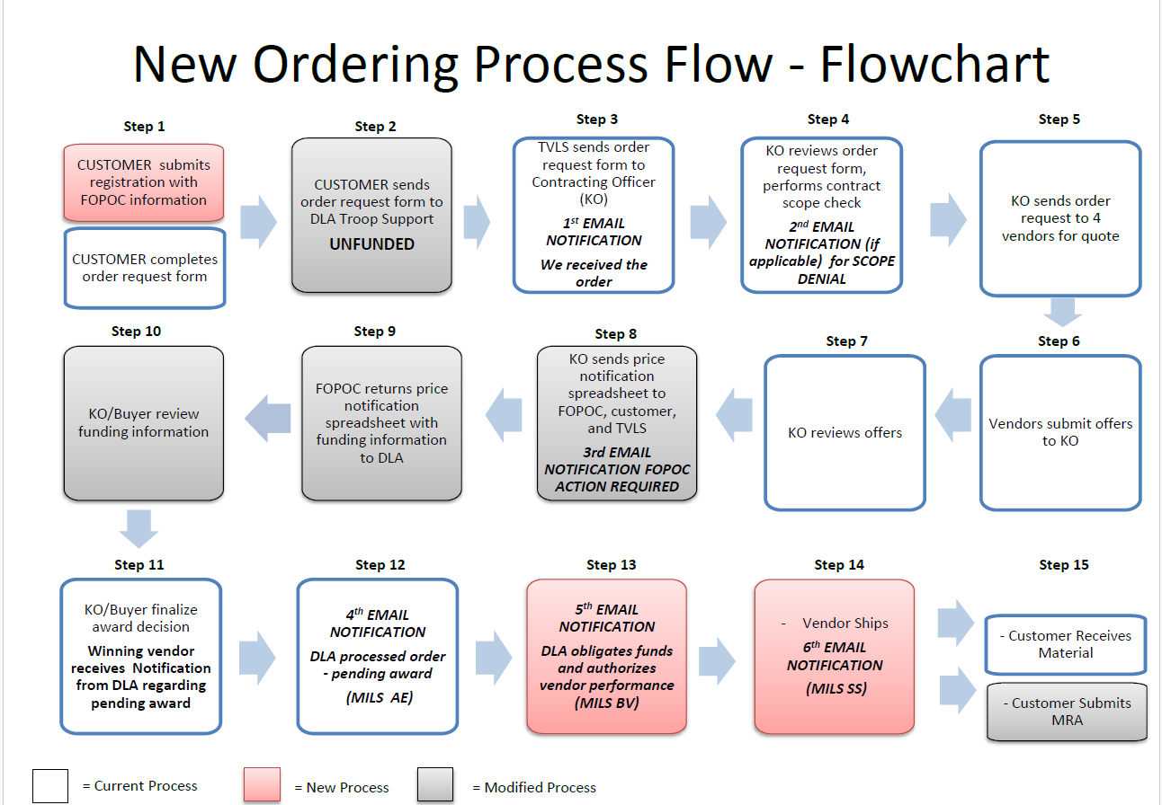
DLA TLS SOE Flowchart
MISSION POSSIBLE

Slide 12

MISSION POSSIBLE

Slide 13
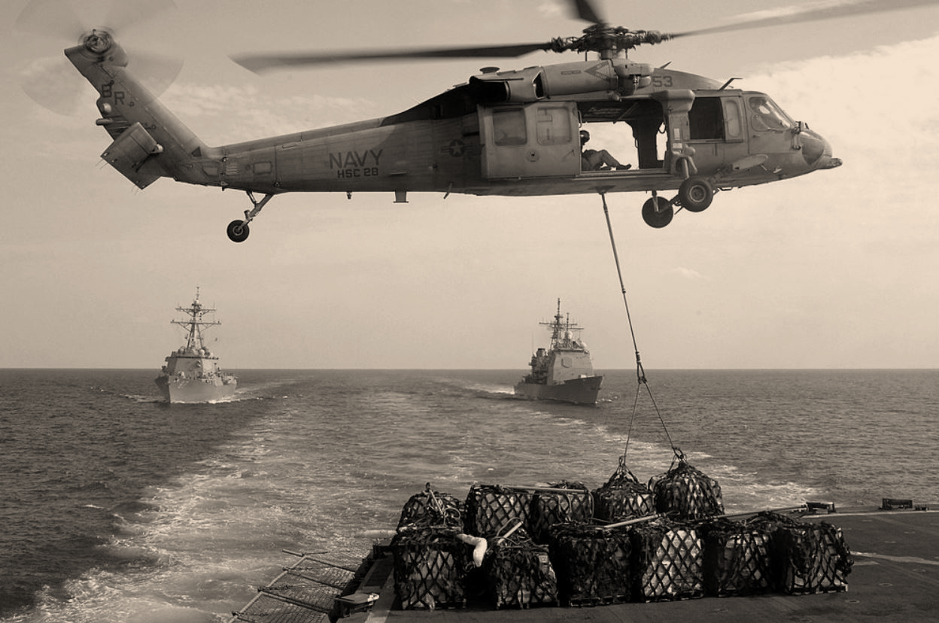
POINTS OF CONTACTS:
Cindy Mattingly
Sr. Director of Business Development
cmattingly@noble.com
(904).707.5847
Mark Good
VP of Contract Operations
mgood@noble.com
(540).383.3687
877-999-1911
support@noble.com
WWW.NOBLE.COM
NOBLE SUPPLY & LOGISTICS, LLC | NOBLE.COM

Slide 14
Thank you!
NOBLE SUPPLY & LOGISTICS, LLC | NOBLE.COM

