Slide 1


National Shipbuilding Research Program- NSRP
2025 Navy STP SYSCOM Technical Information Exchange
Colin Dunlop, NAVSEA 05T2
NAVSEA NSRP Program Manager
Distribution Statement A. Approved for public release: distribution is unlimited.
1

Slide 2
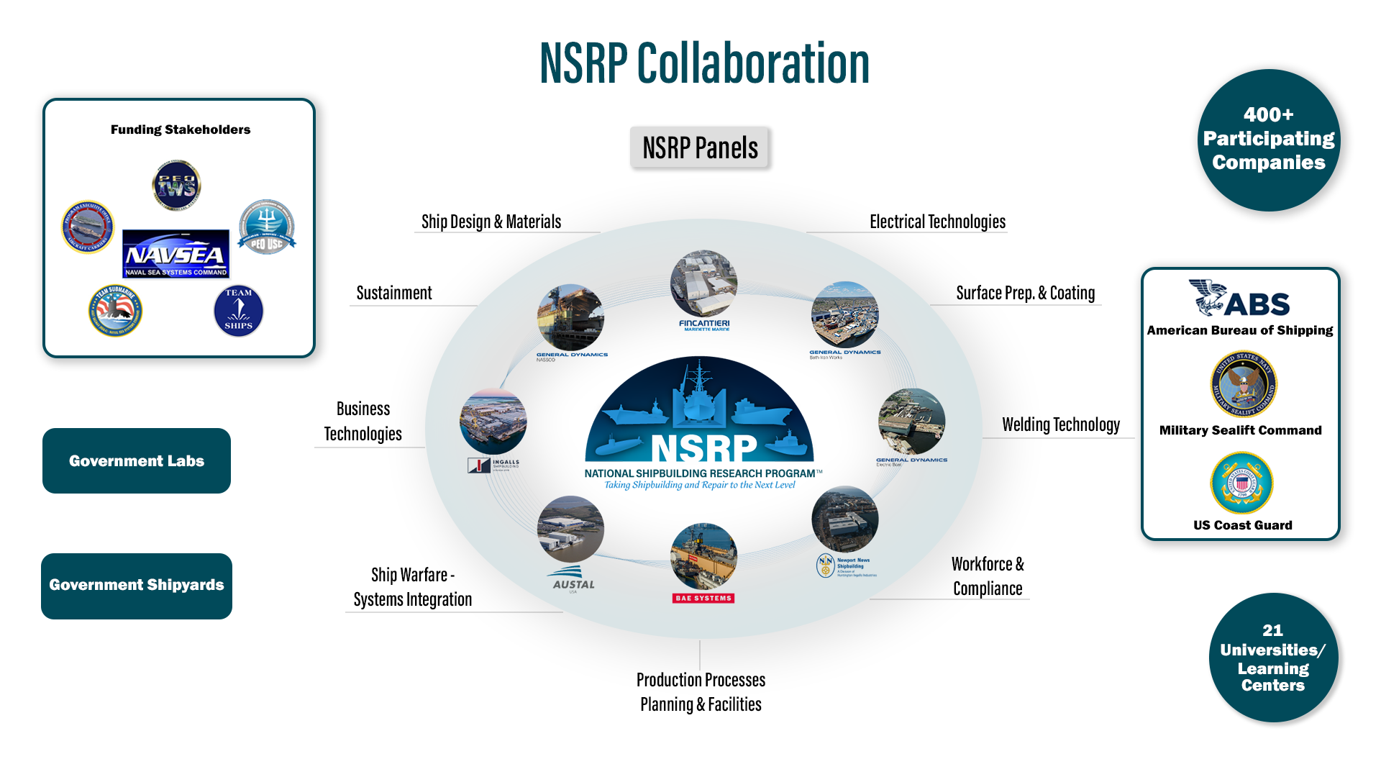
Mission statement: “Employ a unique collaborative framework to research, develop, mature, and implement industry-relevant shipbuilding and sustainment technologies and processes, improving efficiency across the U.S. shipyard industrial base and meeting future demand.”
Distribution Statement A. Approved for public release: distribution is unlimited.

Slide 3
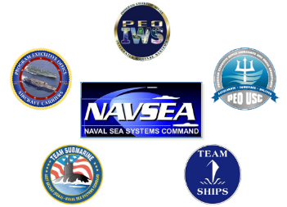


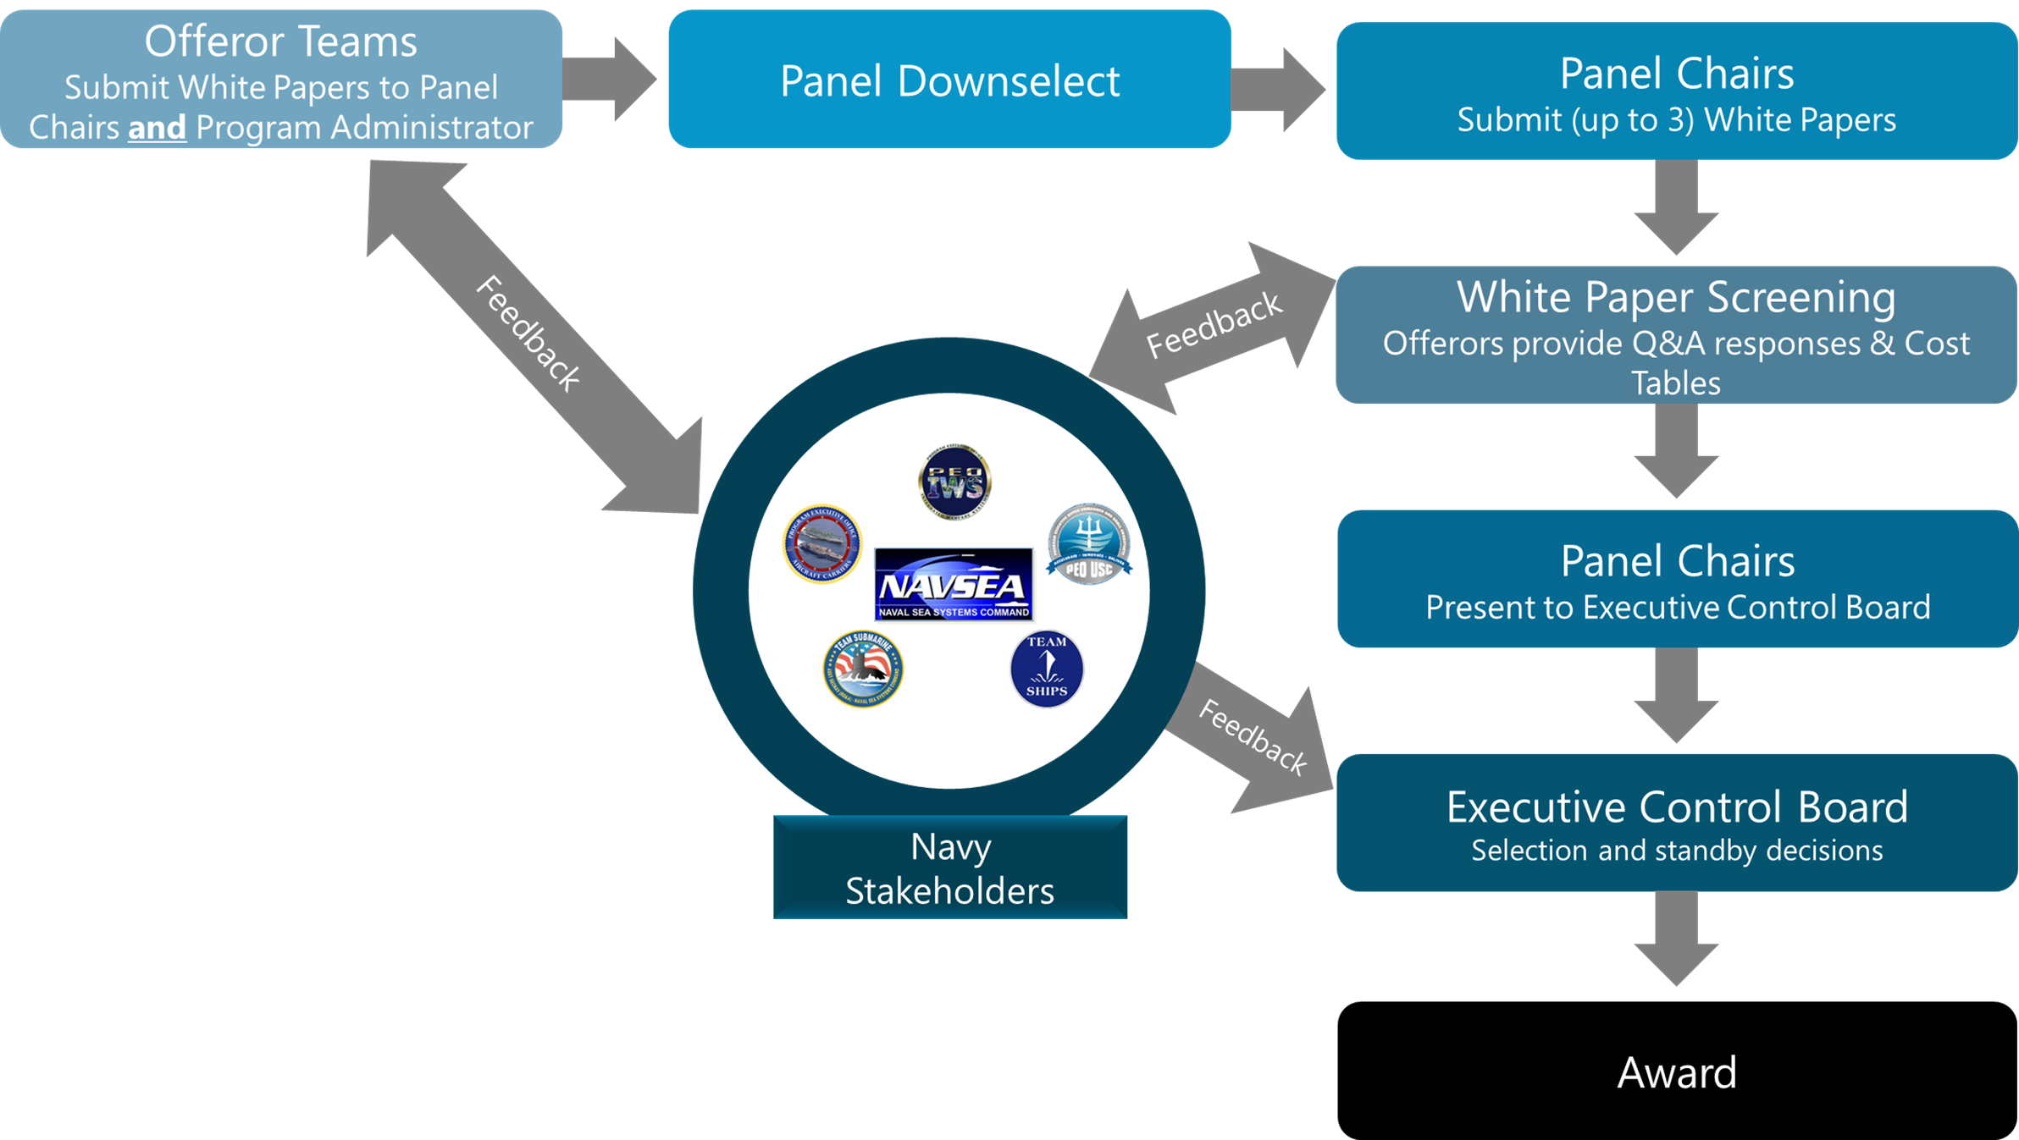
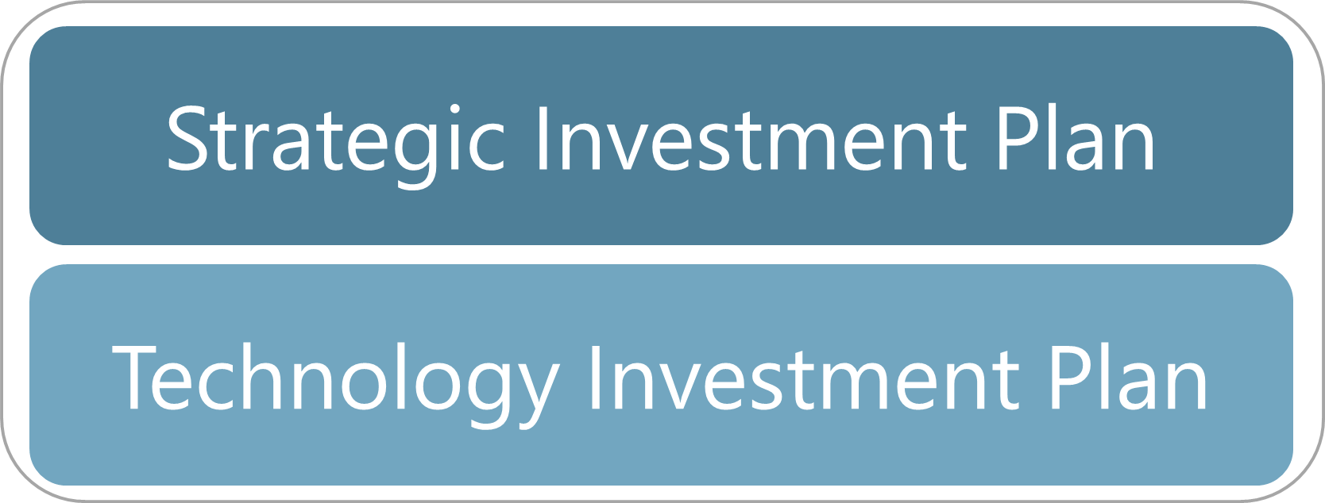
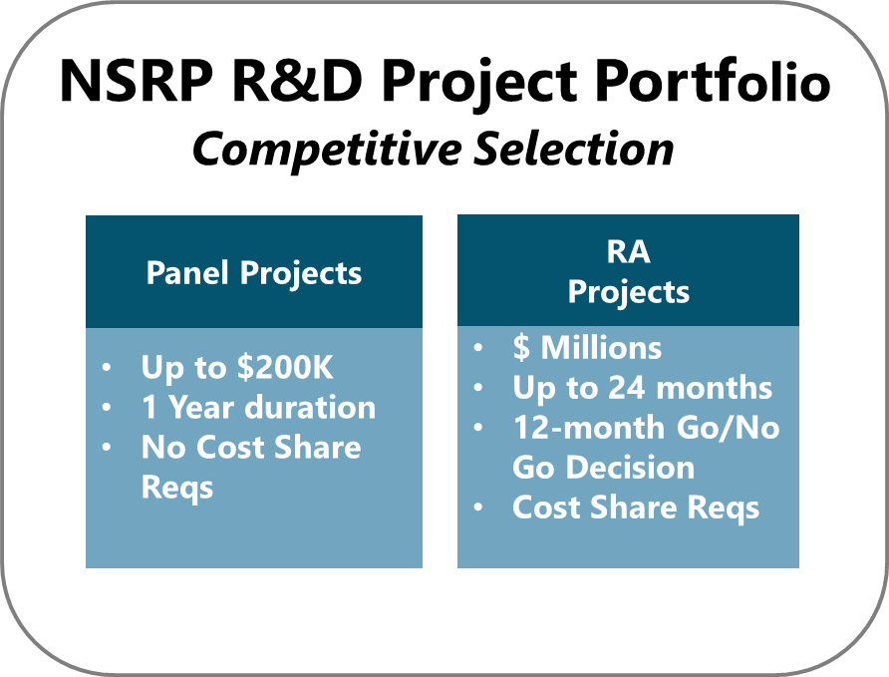



NSRP Operating Model
Navy Stakeholders
Shipbuilding Industry
Project Review & Selection Process
Distribution Statement A. Approved for public release: distribution is unlimited.
3

Slide 4

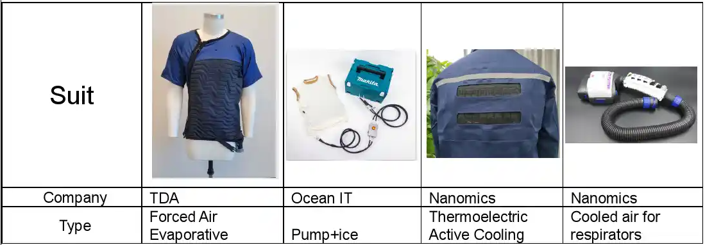
SBIR/STTR Engagement
  Unique pathway for technology transition for Small Business Innovation Research (SBIR) and Small Business Technology Transfer (STTR) Projects
  NSRP Panels meeting provide:
    Network introductions/Teaming opportunities on projects
    Provides a forum for SBIR/STTR awardees to showcase innovative technologies with potential customers (Shipyards/Large Vendors)
    SBIR exhibited at 2023 NSRP All-Panel Meeting
  Example SBIR/STTR Awardee: TDA Research is on two FY24 PP projects for Welders Cooling Clothing:
    Evaluation of Newly-Developed Cooling Suit for Improved Worker Efficiency
    Body Cooling Technology Study
SBIR/STTR Coordination
  NSRP PM attends NAVSEA SBIR/STTR technology reviews to identify potential NSRP partnerships
    Provides NSRP awareness of innovative small business aligned to NSRP Mission
    Attended NAVSEA SBIR Innovation Forum to encourage SB participation in Panels and solicitations
NSRP is aligned to support and leverage SBIR/STTR Transitions
Distribution Statement A. Approved for public release: distribution is unlimited.
4

Slide 5
Engagement in NSRP
There is an NSRP panel for every discipline of shipbuilding and ship repair
NSRP panels are excellent opportunities to discuss topics with industry as a group
  Attend panel meetings
  Seeking additional panel members
Engagement helps improve shipyard industrial base capabilities
  Identify technical needs
  Review proposals for technical fit and Navy interest
  Submit proposals (RA and Panel) as active participant
  Identify the technical requirements for success
  Monitor project progress
Stay informed
  Regular panel meetings 2-3 times per year
  Articles in The Observer, competency newsletters and LinkedIn
  www.NSRP.org
  Email NSRP@ati.org to get on NSRP Send out List (Panels and General)
NSRP panels and projects help address Navy shipbuilding needs
Distribution Statement A. Approved for public release: distribution is unlimited.
5

