Slide 1


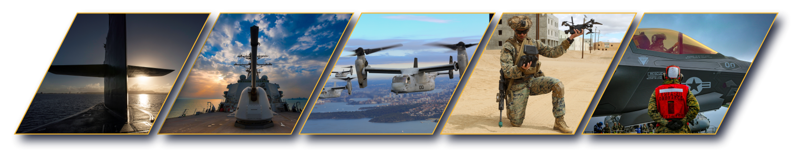

Navy STP Overview & VTM Demo
Don Williamson
CAPT, US Navy (Ret)
Prime Liaison Business Consultant
Phone: (509) 310-3831
Email: donald.williamson@ATSICorp.com
www.navystp.com
Notes:
Welcome the 24th Navy STP Kickoff. You have already heard from Mr. Smith the Navy’s SBIR/STTR director and Mr. Sullivan, the Navy’s STP Program Officer. I am the Navy STP Program Manager. Over the next 30 mins, I will walk you through what Navy STP does to help you achieve your goal of a Phase III transition and what Navy STP needs of you for this program to add value for your small business

Slide 2
What is SBIR?
SBIR / STTR:
  Small Business Innovation Research (SBIR); work with USG/Defense Primes
  Small Business Technology Transfer (STTR); work with non-profit/Research lab
A Small Business is defined as:
  Fewer than 500 employees
  Business located in USA
  American owned, at least 51% US citizen ownership
SBIR Process Overview:
  USG/Navy generates SBIR “needs statements”
  Small Businesses respond with a white paper proposal for Phase I
  USN evaluates submissions and competitively selects Small Businesses
  Phase I: 6-12 month PoP; Award value $50,000 - $240,000 ($150K)
  Phase II: 6-24 month PoP; Award value capped at $1,800,000 ($1.5M)

Slide 3
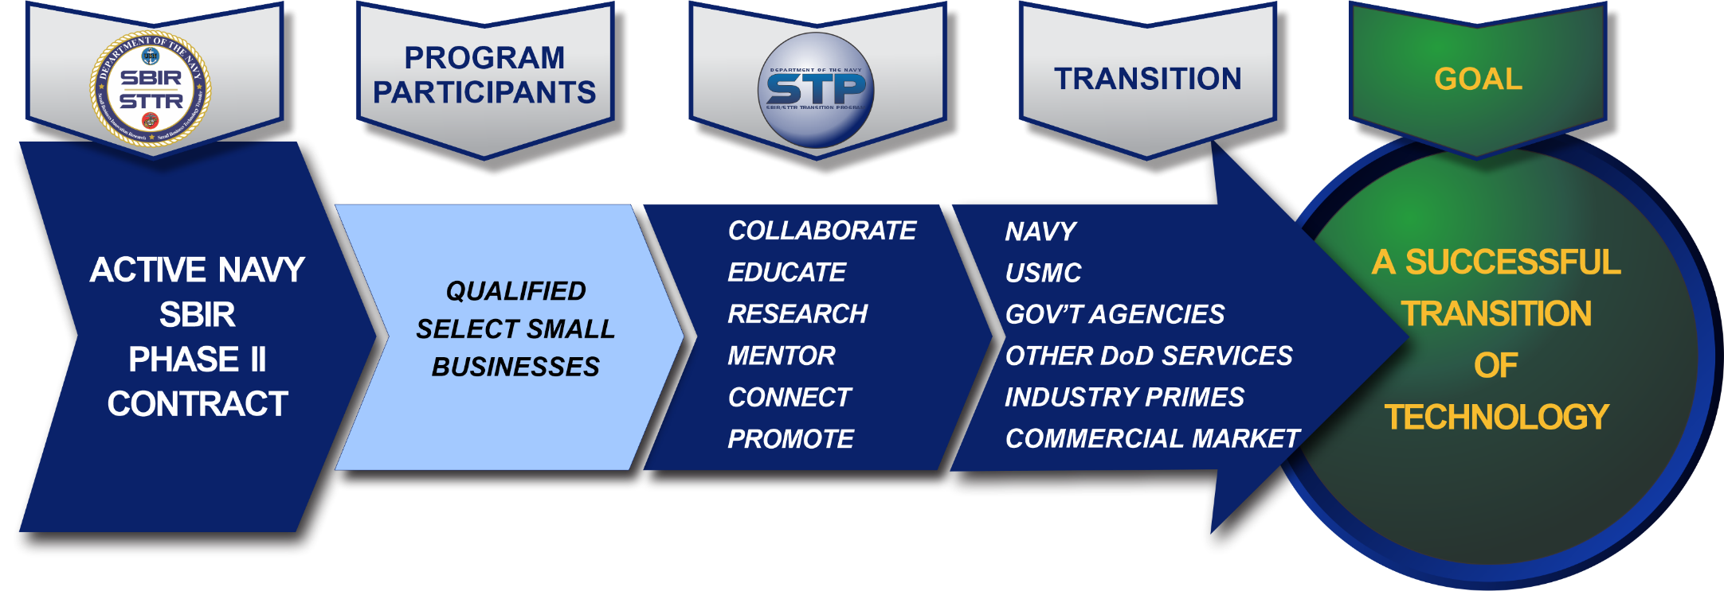
Navy STP
Navy STP (SBIR/STTR Transition Program) now in its 25th year
Navy STP is a Navy-funded program; Navy is only Service with such a program; Navy awards +$500M in SBIR annually. Navy gets 25% of DoD SBIR funding but generates 65% of SBIR Phase III transition awards garnering a 19% ROI for Navy
Navy STP connects SBIR/STTR-funded technologies with warfighters, government acquisition and technical personnel, prime contractor and system integrators
~120 small businesses enroll to participate in Navy STP annually.
1 June – 31 May Annually

Slide 4
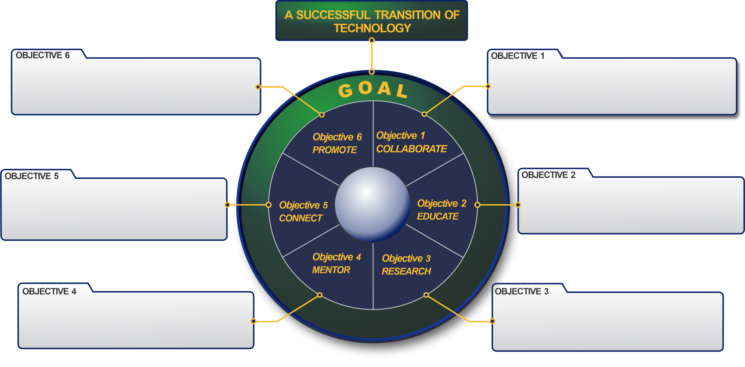
What We Do
Promote Department of the Navy SBIR / STTR Transition Success and SBC Technologies and Transition Successes​
Collaborate in the development of SBC technology marketing materials​
Connect SBCs’ technologies to government end users and prime contractors​
Educate SBCs on tech transition issues​
Mentor SBCs on Business, Marketing and Transition Strategies​
Research market and transition material and provide SBC with a written report ​
1 June – 31 May Annually
Notes:
The 6 action Verbs
Mention – products and or actions performed in each

Slide 5

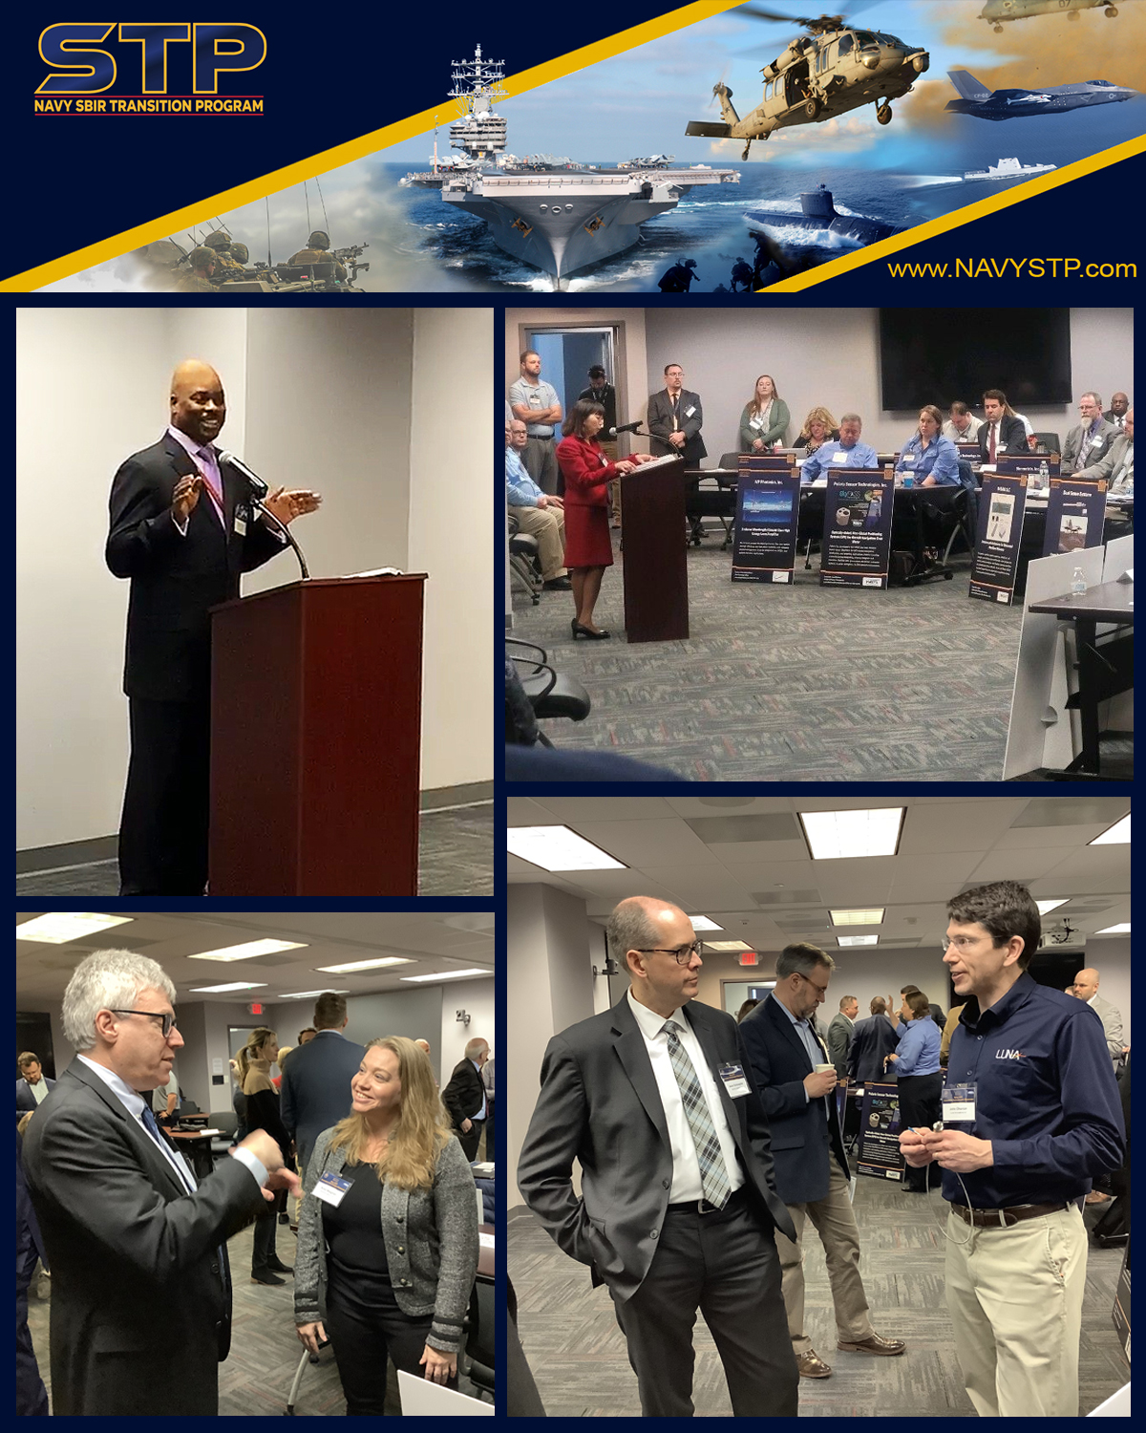



Navy STP Engagement
January 28-30, 2025
San Diego, CA
March 11-12, 2025
Arlington (Roslyn), VA
April 6-9, 2025
National Harbor, MD

Slide 6
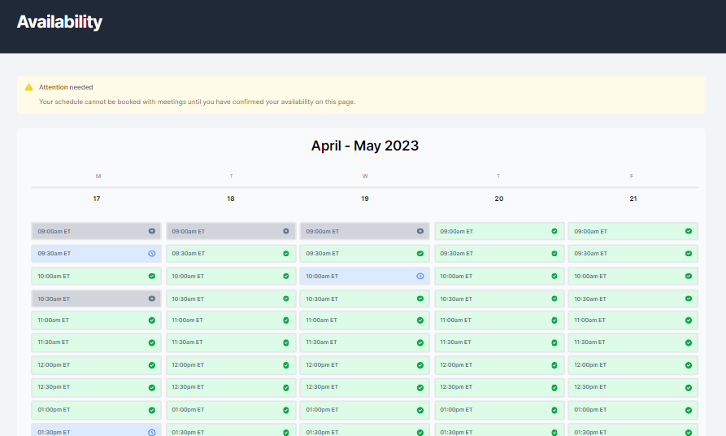

Navy STP Connect
Software platform to connect participating Small Businesses to industry primes and government representatives
Allows scheduling of one-on-one meetings to discuss the SBCs’ technology and potential transition opportunities
Allows industry primes and government representatives to schedule and connect with SBCs whose technology they may be interested in
A link will be sent to potential participating customers to complete the registration page and set up access to the Workspace.
March & April 2025

Slide 7
Navy STP Prime Liaison
The Prime Liaison’s role is to seek transition opportunities for Navy STP small businesses with industry partners
The Prime Liaison works with Prime contractors (mostly Defense, but some Commercial) to understand their emerging technology requirements for current Programs of Record or their market adjacency needs
Creates long-term relationships with Primes and seeks win-win solutions for both the Primes and SBCs
Typical model includes a series of Technical Interchange Meetings (TIMs) with the Primes. The initial engagement with a Prime is to provide Navy STP overview and VTM demo. This is generally followed by a second engagement with a Prime’s broader leadership team. Then, a TIM between the Prime and one or more small business, with or without Navy STP participation.

Slide 8
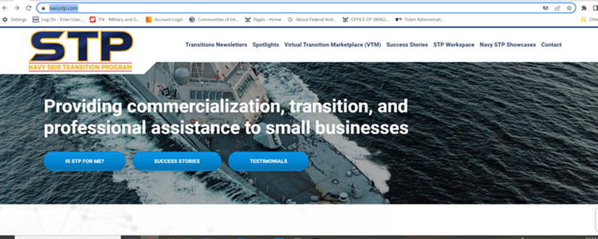
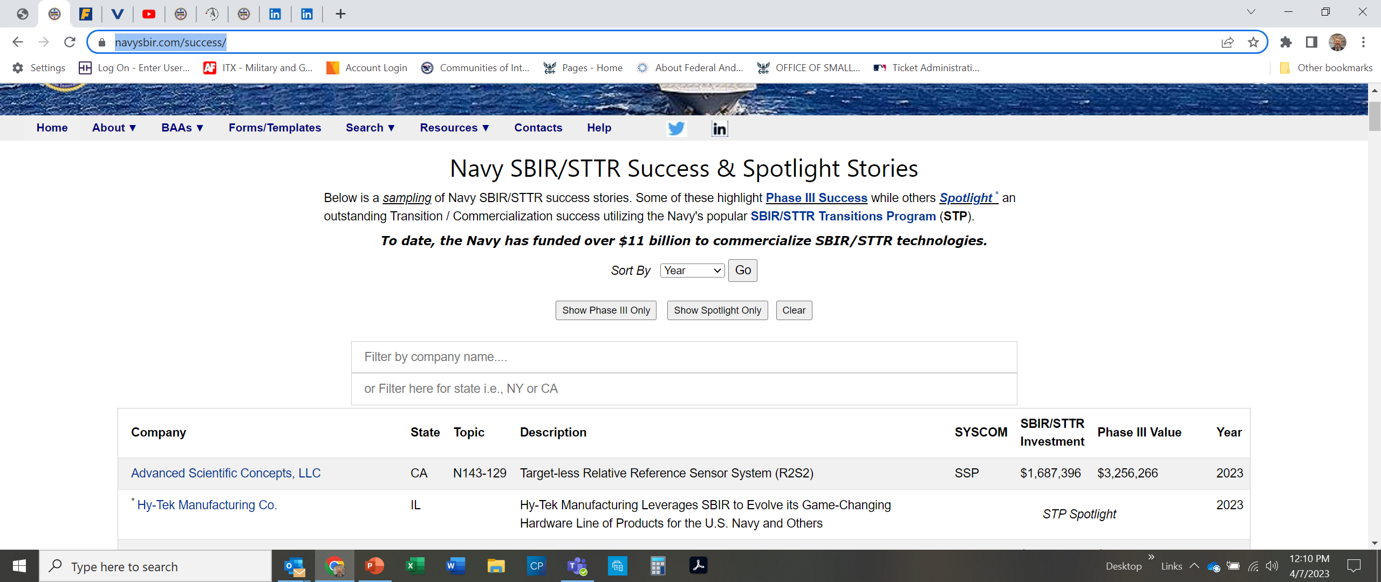
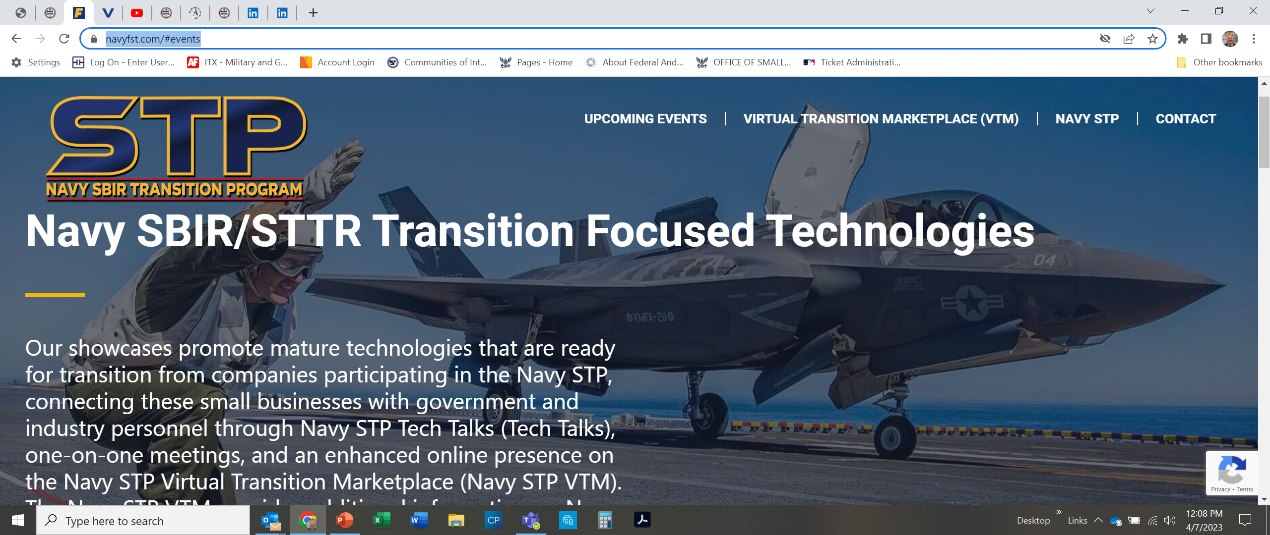
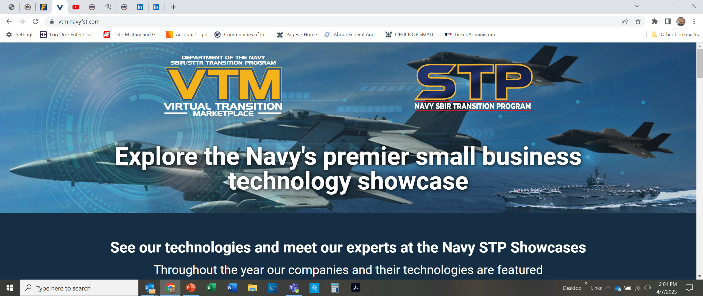
Navy STP Links
https://navystp.com/
https://www.navysbir.com/success/
https://navyfst.com/#events
https://vtm.navyfst.com/

Slide 9
Summary
Navy STP is a Navy-funded program administered via ONR
Navy drafts the SBIR “needs statements” for areas of interest or future requirements
SBIR Phase I and Phase II are competitively awarded contracts by Navy and Industry can contract with a SBIR-awarded small business directly, no competition required
Navy invests $1M+ per SBIR Phase II small business technology. Navy invests +$500M annually in SBIR contracts. Navy receives 25% of DoD SBIR funding but generates 65% of SBIR Phase III transitions garnering a 19% ROI for Navy
Partnership/investment with SBIR Small Businesses provides industry a “running start”, in terms of both schedule and budget…in the right direction (Navy interest)
Navy STP team can coordinate opportunities for industry and Primes.

Slide 10
QUESTIONS?
Don Williamson
CAPT, US Navy (Ret)
Prime Liaison Business Consultant
Phone: (509) 310-3831
Email: donald.williamson@ATSICorp.com

Slide 11
Navy STP Connect
Registration: Opens March 17
Scheduling: April 14-25
Software platform to connect participating Small Businesses to industry primes and government representatives
Allows scheduling of one-on-one meetings to discuss the SBCs’ technology and potential transition opportunities
Allows industry primes and government representatives to schedule and connect with SBCs whose technology they may be interested in
A link will be sent to potential participating customers to complete the registration page and set up access to the Workspace.
March & April 2025

Slide 12

2025 Navy STP SYSCOM
Technical Information Exchange

