Slide 1
Department of the Navy (DoN)
Small Business Innovation Research (SBIR)
Experimentation Cell (DoN-SEC)
STP Showcase: DoN-SEC Overview
March 2025

Slide 2

About Us
We are a team that connects SBIRs with the DoN experimentation community to deliver innovative solutions for the warfighter.
Since establishment in 2020, our mission is to support the SBIR community by offering facilitation, mentoring, and training in all aspects of experimentation.
We highlight the benefits of using experimentation to explore and assess capabilities of emerging SBIR technologies.

Slide 3
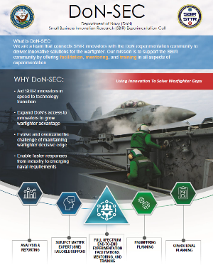
Mission
Program Goals:
Empower the SBIR community to more effectively utilize experimentation benefits.
Enhance SBIR Transitioning of technological innovations through effective and relevant experimentation efforts to solve warfighting problems and receive valuable feedback.
Increase awareness of experimentation opportunities for the SBIR community.
Simplify experimentation processes with informative guidebooks.
Experimentation can provide Objective Quality Evidence (OQE) to support transition

Slide 4
Who We Support
  SBIR Programs
    PMO
    TPOC
    Small Business
  Entire Naval Enterprise
    R&D Community
    Acquisition Community
    Operational/Fleet Community
OPERATIONAL COMMANDERS
Outreach
Focus Area Lead
Engineering
Analysis
IMKM
AML
TYPE COMMANDERS (TYCOMS)

Slide 5
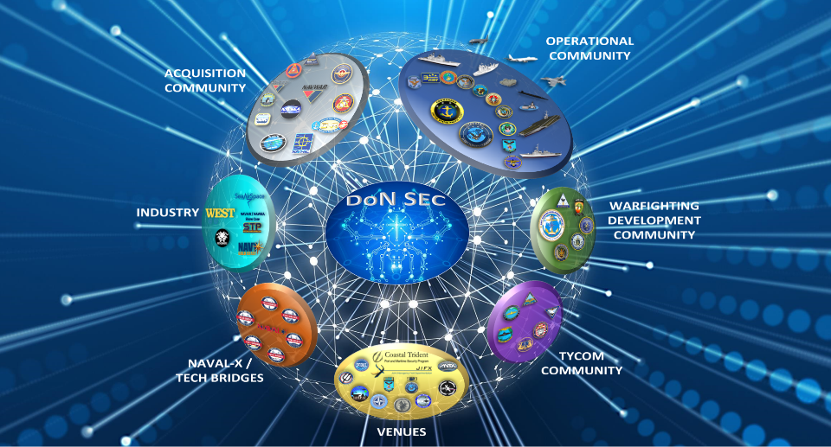
Connections
-

Slide 6
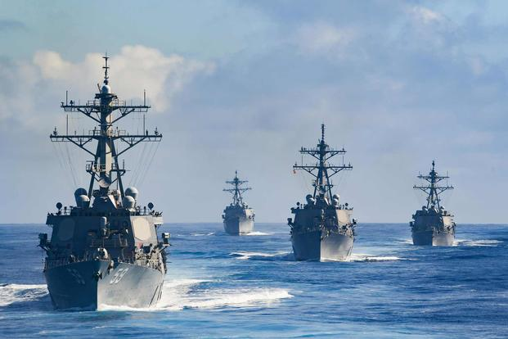
Why Experiment?
Solicit observations and Insights from fleet (USN/USMC) to discover objective based data to support transition decisions
Collect tactical and fleet representatives' observations to validate innovative technologies and/or reduce risk
Enable Build-Test-Build for future research and improvements
Complete an objective, test a theory, or measure a capability to impact a warfighter gap
Receive fleet and developmental feedback prior to acquisition testing and evaluation
“Experimentation, which involves a spectrum of activities including analyses, war games, modeling and simulation, small focused experiments, and large field events among other things, provides the means to enhance naval and joint force development.”
-The Role of Experimentation in Building Future Naval Forces, National Research Council
Experimentation can provide Objective Quality Evidence (OQE) to support transition

Slide 7
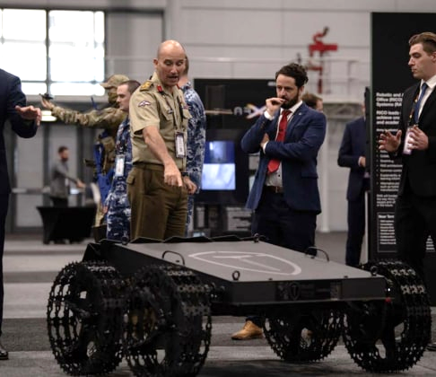

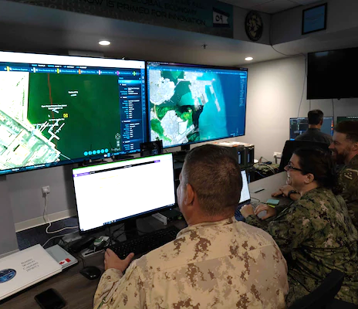
Key Differences
Demonstration
  “Let me show you what I can do with…”
  Previously conducted multiple times
  Not measuring against standards
  Known Outcome
  The intent is to Share Knowledge
Experiment
  “Let’s see what will happen when we …”
  Not previously conducted / explored
  Not measuring against standards
  Unknown Outcome
  The intent is to Learn What Works
Test and Evaluation
  “Let’s prove or disprove whether it meets… “
  May or may not have been conducted previously
  Measuring against standards
  Expected Outcome
  The intent is to Determine if it Works the Way it is Intended to
Notes:
Experiments are exploring a theory about the technology.
T&Es are designed to determine if a technology meets specific standards.

Slide 8
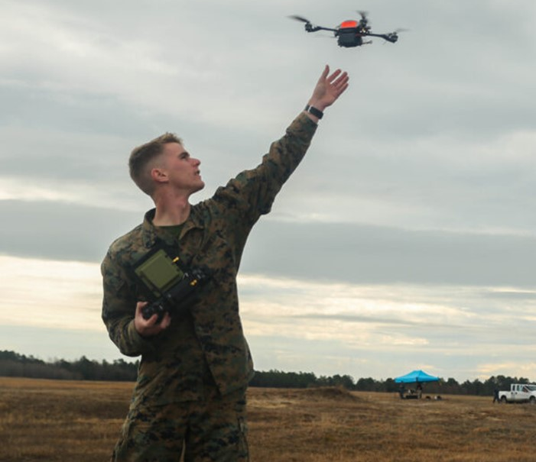
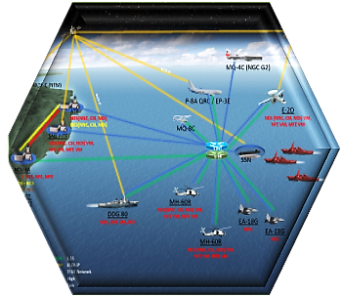
A Spectrum of Event Options
One size does not fit all, select based on your needs!
Smaller Scale Events:
More control of elements
Minimal entrance criteria
Limited resources and interactions
Limited exposure
Larger Scale Events:
Extensive interactions available
Large number of observers
Opportunity to study interaction/integration
Significant requirements for participation
LTE
ANTX
FLEX
TW
LSE
Fleet Integration and Exposure
Complexity and Planning Time
Note: Events listed are just a small sample from a large list of Naval events.
Notes:
Selecting the right event is critical for an experiment to be successful, because not all events are created equal.
Besides the obviously differences like the venue or the potential for international participants, a key difference in events is largely depending on the number of elements taking part, and the associated deconfliction that is required. As such, events can be categorized by their size. With only a few elements that need to be coordinated, small events can provide each experiment with a lot of latitude. Large events on the other hand need to deconflict the many elements and must keep closer control over experiments to ensure they don’t interfere with each other. The lack of flexibility associated with large events is offset by the fact that they often can provide a much wider exposure and have many more opportunity to integrate with other elements. Depending on what a particular technology or initiative needs one size event might be a better fit over others.
Establishing contract with Event staff, a developer team can try to determine if they will be a good match.

Slide 9






Experimentation & Technology Development: Complex Ecosystem
Operations
Air/Waterspace
Installation & Engineering Processes
Involves in-depth SME Knowledge and certifications
GPS EA
Regulators
RF EA
DoD/National Coordination
SPECTRUM
Acronyms
FAA
COA
Install/
Cyber
NAVSEA
(NMP/SCD/RMCO)
AI Artificial Intelligence
ASN Assistant Secretary of the Navy
BOS Beyond Line of Sight
C4I Command, Control, Communications, Computers and Intelligence
COLREGS Convention on the International Regulations for Preventing Collisions at Sea
FASFAC Fleet Area Control and Surveillance Facility
IFC Interim Flight Clearance
ISR Intelligence, Surveillance, and Reconnaissance
NMP Navy Modernization Program
RMF Risk Management Framework
SME Subject Matter Expert
UAS Unmanned Aerial Systems
USV Unmanned Surface Vessel
UUV Unmanned underwater vehicle
Organization
Warning /Restricted area
FASFAC
Process
Process
NAVAIR
IFC
-
Experimentation
Ecosystem
NAVWAR
(TEMPEST/OPSEC)
Organization
NAVWAR
RMF/AI
Authorities to Experiment IAW International & National Law/DoD Ranges
Process
FLEX/NWDC
Follows instruction and FLEET needs/gaps
NAVSEA
(COLREGS/UTM)
Organization
Unmanned Systems
FLEET
Interoperability and Integration with FLEET and Joint Forces
Unique systems subject to DOD and National compliances (Due regard)
New N44
ANTX
RDER
JOINT
NAVAIR
(BLOS/UTM)
OPNAV/ASN/RDT&E
Legend
Organizational Oversight
Process requirements

Slide 10
Navigating Naval Experimentation
Connections | Processes | Venues
Cost
Proper Selection
Venue
Logistics
Manning
Collaboration
Schedules
Execution
Planning & Participation
Event
Tech Development
Contract
Ops/Eng Processes
Stakeholder Coordination
Performance
Tech Assessment
Data Collection
Commercialization
Potential
Analysis

Slide 11
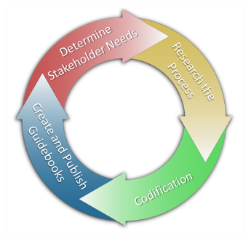
Methods
  Guidebooks:
    SBIR 101 - Basics of Experimentation (tailored for SBIR community)
    SBIR 102 - Ship Riders’ Guide
    SBIR 103 - Installation and Engineering Processes
    SBIR 104 - Experiment Analysis & Reporting
    Engineering and Operations Process Guides (EPG/OPG) – Lithium Battery Safety released, others in development
  Facilitation: Lower the threshold for entry and input into experimentation communities
  Mentoring: Develop relationships to increase knowledge and awareness
  Training: Target towards government sponsors and venue owners

Slide 12

Initiative Selection
Two methods of contact:
Push: The SBIR is recommended to us by the Program Manager or brought in by a request from the Technical Point of Contact (TPOC).
Pull: The Performer contacts us directly or event sponsor notifies us of their inclusion in an event.
Business rules:
Introduction interview: Our team meets to determine eligibility and experimentation maturity, and then conducts a fact-finding interview to determine objectives and engineering challenges. If contact was a “Pull,” a meeting will then be established with PM/TPOC to ensure compliance with government objectives and warfighter gap alignment.
All initiative support will be in cooperation with Program Office and TPOC

Slide 13
Resident Expertise
  Experiment Design:
    Problem Statement
    Hypothesis Development
    Objective Development
    DOD Architecture Framework (DODAF) Models
    Liaison to event sponsors
  Engineering:
    Ship Install – SHIPMAIN/NMP processes
    Airworthiness Certification
    Accreditation and Assessment (A&A)
    Mission Readiness Assessment (MRA)
    Application Integration (AI)
    Lithium-Ion battery certifications
    RMMCO processes
  Operations:
    Air/Water space management
    Spectrum (GPS/EA/Allocation)
    Environmental (PMAP/EIS)
    Unmanned systems/DSD Waivers
  Analysis:
    Data Collection and Analysis
    Schedule of Events (SOE)
    Qualitative Analysis/Surveys
    Reporting
Experienced in all phases of experiment planning

Slide 14
Effects
SBIR Initiatives become innovative solutions to fit warfighter needs
  Maximize impact, communicate, and cross-pollinate data
Target premier technical experimentation environments and venues
  Right venue, right event
“Take the load off” staff and amplify the return investment
  More receptive TPOCs and event sponsors
Improve and Enhance
  Do no harm, do not impede efforts

Slide 15
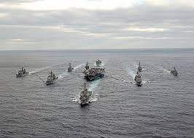

Points of Contact
DoN-SBIR website: https://www.navysbir.com/
DoN-SEC website: https://navysbir.com/sec/
Follow us on LinkedIn!
For further information and support please contact Kelly Carruthers, kelly.b.carruthers.ctr@us.navy.mil and Richard Weiss, richard.p.weiss.ctr@us.navy.mil
Program Sponsor – Mr. Brian Shipley
Director, DoN SBIR/STTR
brian.r.shipley.civ@us.navy.mil

Slide 16
Backup

Slide 17
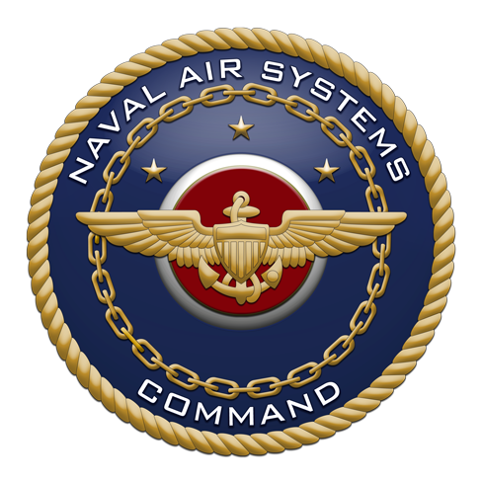

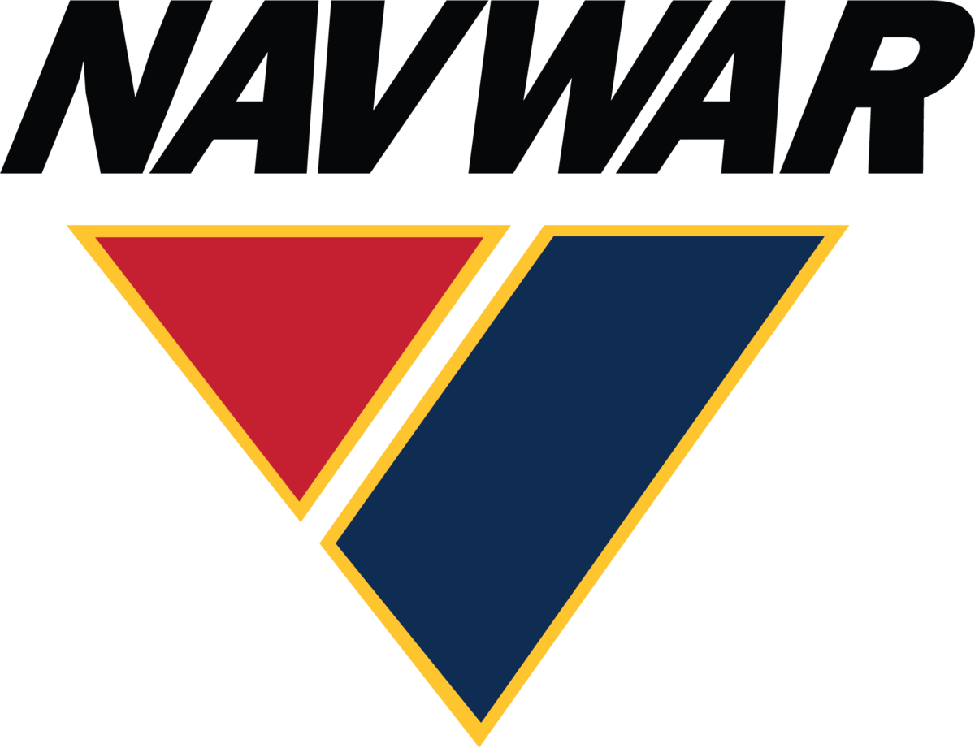




Current Status
Eleven Full Time Employees
  1 Surge support (FLEX/LSS)
Performers Supported
  157+ Actively working towards experimentation
  38 event iterations including Silent Swarm, ANTX CT, Trident Warrior, TOEE series, Northern Edge, JIFX series, C4F HFC, TCE, IBP, and Trident Spectre
  53 are Woman and/or Veteran-owned or fit into the HUBZone and Small Disadvantaged Business categories
  8 SYSCOMs supported, with NAVAIR, ONR, NAVFAC, and MCSC most active
  Note that some initiatives have multiple outcomes/experimentation opportunities
  Performers considered as “Not a Fit” had no current need for DoN-SEC services
Over 400 Initiatives Engaged Since Inception in 2020
Small Business Technology Transfer (STTR)

